Slide 1
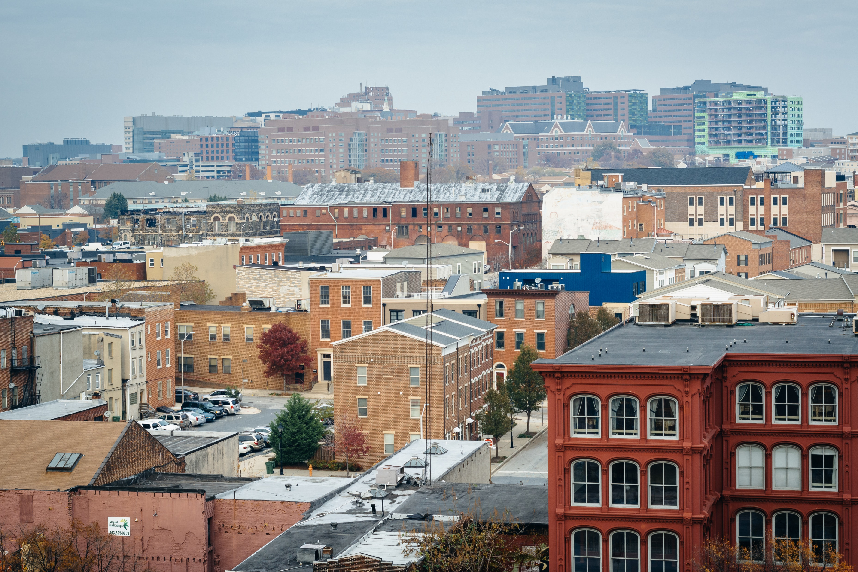
Housing Accelerator Program
Pre-Proposal Conference
September 14, 2023
09/14/2023

Slide 2
SCHEDULE
Public NOFA Announcement: 09/06/2023
NOFA Application Portal Opens: Week of 9/18/2023
Pre-Proposal Conference: 09/14/2023
Application Questions Workshop: 10/05/2023
Application Submission Deadline: 11/01/2023
Awarding: Late November 2023

Slide 3
INTRODUCTION
Through this Notice of Funding Availability (NOFA), the Baltimore City Department of Housing and Community Development (DHCD) is making up to $16 million available from the Housing Accelerator Fund (HAF) and up to $15 million available from the American Rescue Plan (ARP) for the HOME Investment Partnerships Program (HOME) to support the construction of Permanent Supportive Housing (PSH) for individuals and families who are homeless, at risk of homelessness, or in other vulnerable positions.
Subject to demand, affordable housing projects without PSH units will be considered for funding under this NOFA.

Slide 4
INTRODUCTION…CONT.
To be considered for an award of funds, applicants are required to meet threshold requirements and receive a minimum application score of 150 points out of 230 points. Applications will be scored and ranked based on project feasibility, community engagement, and achieving equity. There will be additional opportunities to qualify for a max of 65 bonus points.

Slide 5
ELIGIBLE PROJECTS
Close financing gaps to allow potential projects with supportive housing units to proceed to development.
Secure set-asides of supportive housing units within housing projects already under development through equity investments.
Provide financing to develop new projects and enable their competition for other financing, through pre-development financing grants or loans

Slide 6
ELIGIBLE APPLICANTS
This NOFA is limited to applicants that are either a non-profit, for-profit or joint ventures that are seeking funds to create units accessible and dedicated for permanent supportive housing populations and other affordable housing projects.

Slide 7
AFFORDABILITY RESTRICTIONS
All units funded through the Housing Accelerator Program must restrict leasing and occupancy of those units for a period of at least 30 years to households that have incomes that do not exceed 30% of the Area Median Income (AMI).

Slide 8
ELIGIBLE USES OF FUNDS
HOME-ARP funds are available to support the hard costs of eligible projects. Housing Accelerator funds are available to support both the hard and soft costs of eligible projects. Applications will be evaluated for eligibility under both HOME-ARP and Housing Accelerator funds. Applicants are encouraged to outline why one funding source may be more appropriate for their project than the other.
Eligible uses of funds include | Housing Accelerator Fund | HOME-ARP
Architectural and Engineering | X
Environmental assessment and testing | X
Market and Financial Feasibility Analysis | X
Carrying Costs | X
Zoning Analysis | X
Staff Time | X
Development consultants | X
Legal Fees associated with closing, financing, and drafting legal documents necessary for development | X
Development hard construction costs defined in 24 CFR 92.206(a) | X | X

Slide 9
INELIGIBLE USES OF FUNDS
Ineligible Uses
Acquisition of City-owned properties
Acquisition of properties through receivership
Acquisition of properties through tax sale
Staff that are not directly related to predevelopment, construction, or maintenance of the project general operating costs such as rent, utilities, or operating supplies
Relocation
Repayment of existing loans or liens
Community gardens or urban agriculture uses
Projects that support a specific religious or other affiliation
Commercial, retail, or economic development uses
Costs associated with the preparation of this NOFA submission

Slide 10
HOW TO APPLY
Only electronic submissions through the Neighborly application portal will be accepted. Applicants must submit one (1) complete online submission of their application.
Applications are due by 4:30 PM EST on 11/01/2023.

Slide 11
Completing the Online Neighborly Application for City Grants

Slide 12
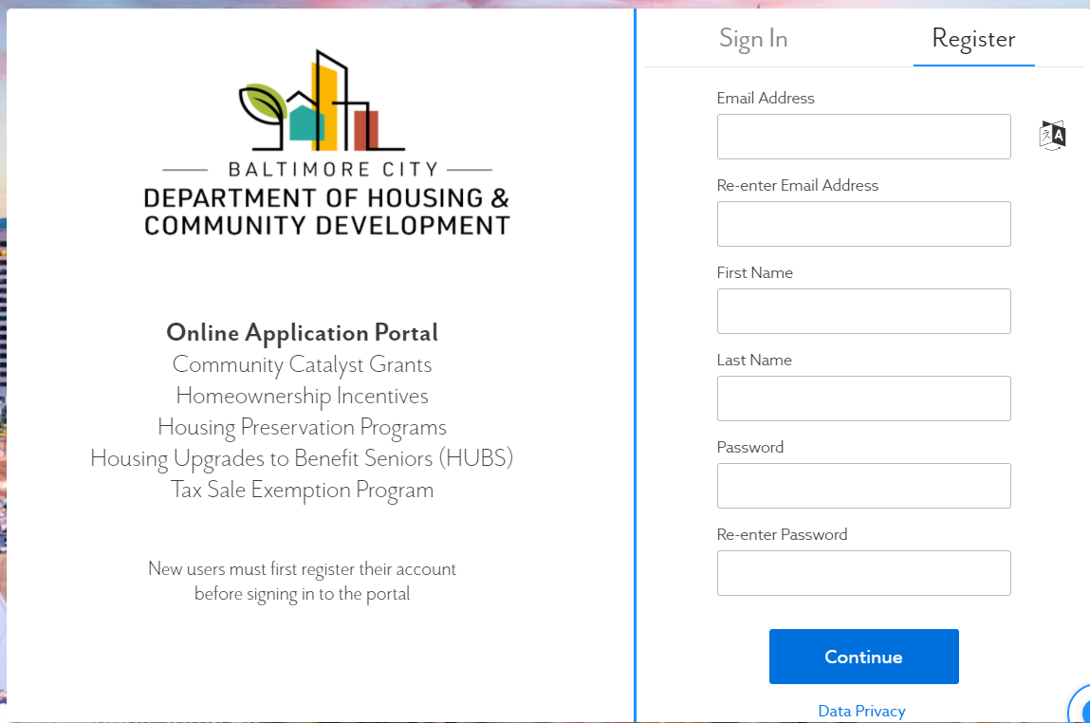
Click here to register
Register Your Account and Sign In
Navigate to https://portal.neighborlysoftware.com/baltimoremd/Participant#
Notes:
Navigate to https://portal.neighborlysoftware.com/baltimoremd/Participant# to begin your application.
If you do not yet have a Neighborly account, please “register,” then verify your e-mail address to log in.
_________________________________________________________
For a more in-depth walkthrough of completing the CCG Capital application, please visit https://www.youtube.com/watch?v=4tdxRJf_n0A for a video tutorial.

Slide 13
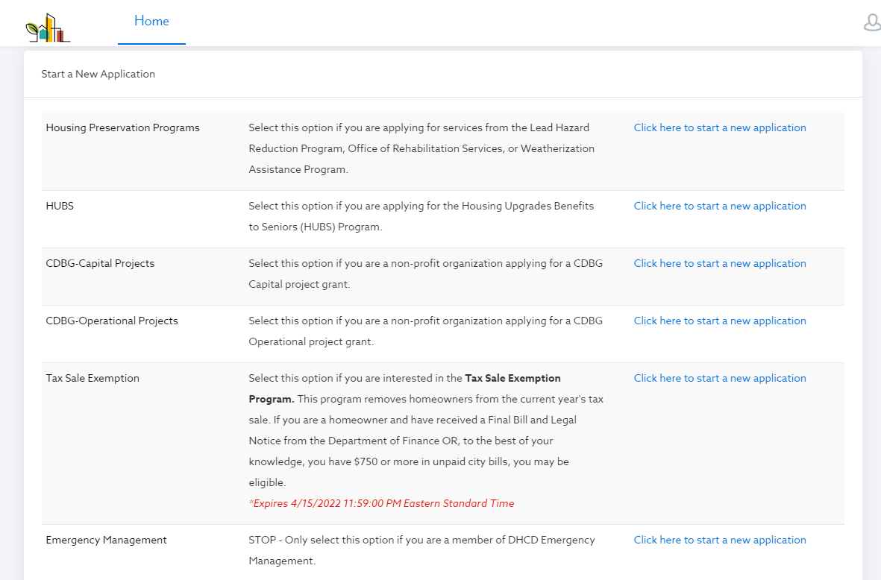
Start a New Application
Notes:
From your participant home page, scroll down to the list of possible applications you may submit. Locate the program you want to apply for and then select “click here to start a new application.”

Slide 14
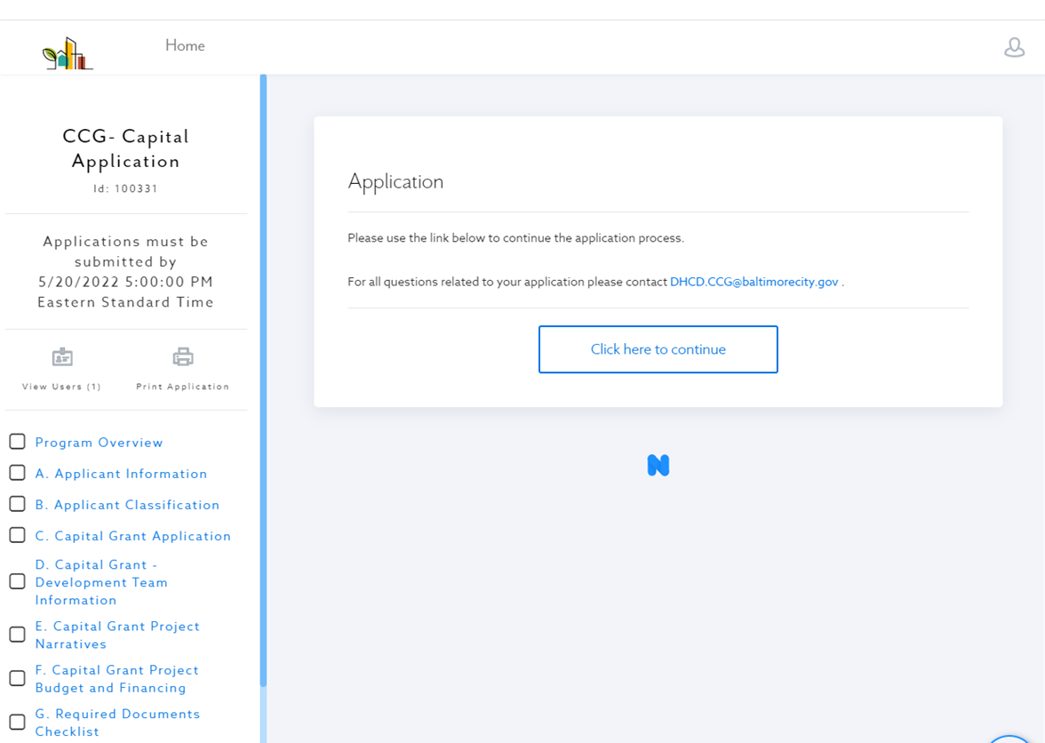
Click “Home” at any time to go back to your Participant Home Page
Navigating the Application
Use this button to view or add users to your app.
Use this button to print your app.
Use this sidebar to navigate to different sections of the application
Notes:
Once you have begun your application, you will see a sidebar on the left which will be your key navigation tool.
Click “View Users” to see the e-mail accounts associated with your application. Here, you can add additional users to give them access to view and edit the application.
Click “Print Application” to print or save a PDF of your full application.
Use the left side bar to navigate between different pages of the application. A green check mark will appear in the boxes next to application pages when they have been completed to provide you a visual cue of what you have and have not finished.

Slide 15
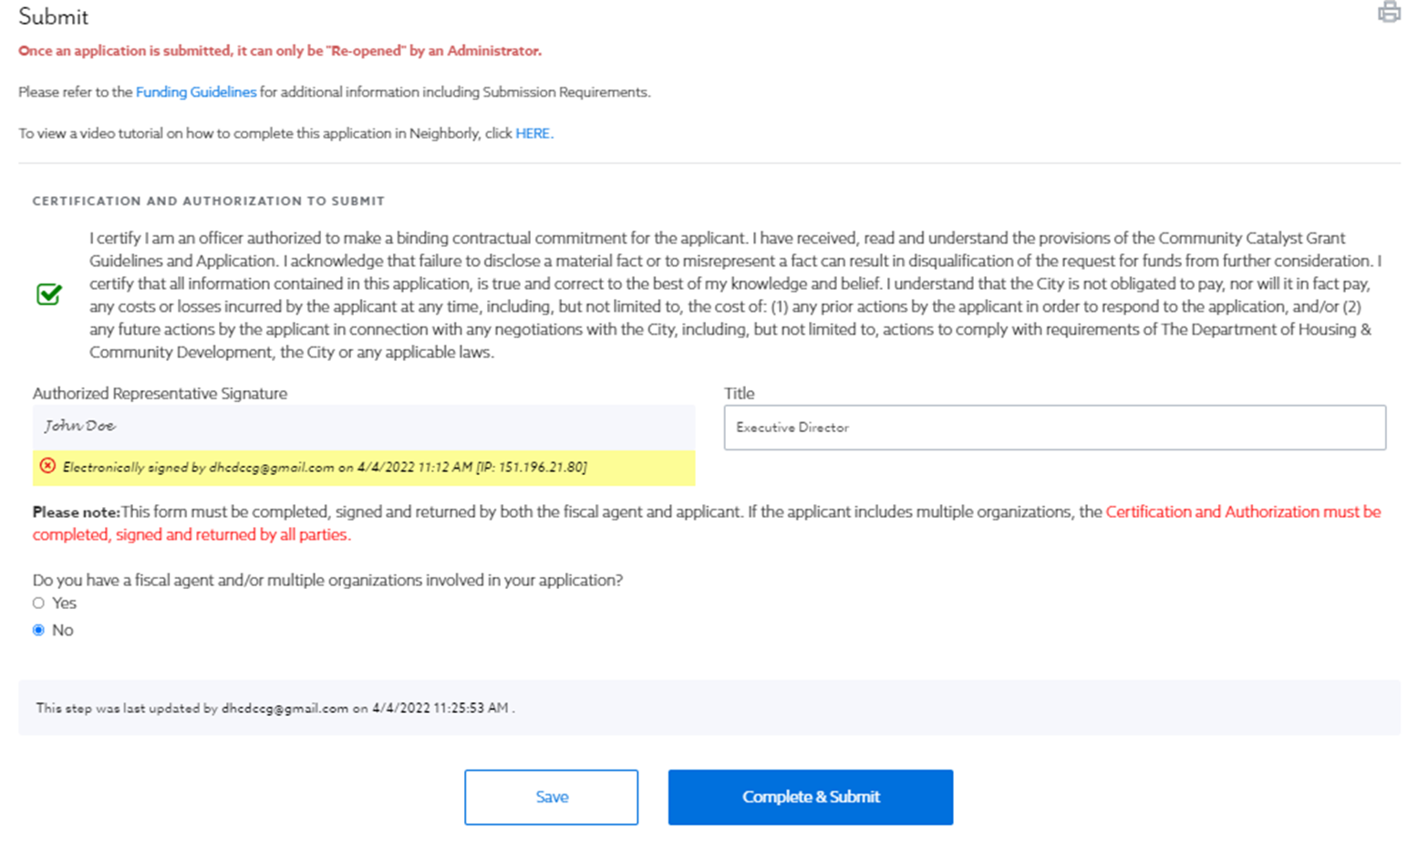
Once submitted, only an administrator can “re-open” the application.
Submit
SAVE when you want to come back later.
SUBMIT when your application is complete.
Notes:
Please only SUBMIT your application when it is complete and ready for review. Once submitted, you cannot make further changes, and only an administrator can re-open your application.
When ready, hit “Complete and Submit.”

Slide 16
Click here to VIEW or EDIT your application.
Check the status of your application.
Locating your application
Notes:
To locate your in-progress or submitted application, log in to your Participant Portal. You will see the STATUS of your application, as well as a link to view or edit your application.
_________________________________________________________

Slide 17
APPLICATION, SCORING, AND BONUS POINTS
The application consists of four (4) parts:
threshold requirements
financial review
scored criteria
signed certifications and authorizations

Slide 18
THRESHOLD REVIEW
Threshold review includes organizational, financial and compliance-related documentation and is used to determine whether an application is eligible for review. Examples of threshold requirements in this NOFA include but are not limited to: Commitment to comply with the City’s Minority and Women’s Business Participation (MBE/WBE) and Local Hire requirements; being in good standing with the State of Maryland and meeting the fund requirements.
Applicants must include all items on the threshold checklist or the application will be determined to be ineligible for review. DHCD will notify applicants electronically whether their application has met threshold review and will post an updated summary on its website.
CSH Commitment to Quality Checklist

Slide 19
SCORED CRITERIA
Applications that meet all threshold criteria will be scored and evaluated according to the following criteria:
Project Feasibility (70 Maximum Points)
Management Plan (25 Maximum Points)
Number of PSH Units (20 Maximum Points)
Community Engagement and Participation with Permanent Supportive Housing (PSH) Community (25 Maximum Points)
Achieving Equity (25 Maximum Points)
Bonus Points (Housing Accelerator and HOME ARP) - 65 Maximum Points
Scored criteria is intended to ensure that awards are made to proposals that meet the fund’s criteria, are designed to have a demonstrated impact on reducing homelessness can leverage other sources of funds, complete projects providing Supportive Housing units, can meet City, State and private lenders’ underwriting criteria, and can be completed within a reasonable timeframe.

Slide 20
PROJECT FEASIBILITY (70 MAXIMUM POINTS)
DHCD to determine whether projects are ready to proceed and that the applicant has the experience, staff and consultants in place to ensure a successful outcome. The requested information must demonstrate that projects are ready to proceed and can be completed within a 24-month time frame of executing a Funding Agreement with DHCD.

Slide 21
MANAGEMENT (25 MAXIMUM POINTS)
Additional consideration shall be given to development teams with a reputable management team and experience developing projects with PSH units.
Developers must include the name of the management company, a list of the management company’s current projects, and current resumes from the management company’s development team. The management team will need to be able to ensure the compliance of subsidy of the units and day-to-day management of the units.

Slide 22
NUMBER OF PSH UNITS (20 MAXIMUM POINTS)
Project that incorporates units dedicated for Permanent Supportive Housing must commit to a leasing preference of 25% of units for people referred through Baltimore’s Coordinated Access system.
To maximize the number of dedicated Permanent Supportive Housing units produced through this funding, projects that commit more units will receive priority for funding.

Slide 23
ACHIEVING EQUITY (25 Maximum Points)
DHCD is committed to using grant funds to reduce the financial, social and economic disparities that have affected many of the City’s neighborhoods and residents over the past several decades. DHCD is also committed to reducing the number of homeless residents living in the City.
To that end, applications will be scored based on location, supporting blight elimination (i.e. demolition and/or rehab), providing supportive housing units, providing priority to returning residents and supporting and building residents’ ability to create equity and wealth.

Slide 24
BONUS POINTS Housing Accelerator and HOME ARP (65 Maximum Points)
Long Term Affordability (up to 15 points)
Organizations led and/or owned by Black developers (up to 15 points)
Project readiness and ability to complete project in line with performance timeline of accelerator program funding timeline (up to 10 points)
Supports & Grows Local Businesses (up to 5 points).
Takes Advantage of Apprenticeships and Training programs (5 points).
Local Hiring Criteria (up to 5 points).
Environmental Sustainability (5 points).
An organization that is a qualified CHDO (5 points)

Slide 25
REVIEWING AND AWARDING FUNDS
Applications will be reviewed by an inter-agency committee with experience in affordable housing, PSH development and finance.
Applications that meet threshold criteria will be reviewed, scored and ranked by the committee who, at their discretion, may submit written requests for additional information, request applicant interviews or tour the proposed project sites.
The committee will provide recommendations to the Deputy Commissioner who will review and submit to the Housing Commissioner. The Housing Commissioner, at his/her sole discretion, shall have the ability to determine final awards.

Slide 26
UNDERWRITING AND AVAILIABILITY OF FUNDS
Following written notification of an award, DHCD staff will schedule an initial meeting with the applicant to review the schedule and how funds will be made available.
During this meeting staff will review the agency’s underwriting requirements and will work with the applicant to discuss and develop a project schedule.
Applicants are advised that no funds shall be made available until such time as the Board of Estimates has granted approval and transactional documents have been issued by the department.

Slide 27
MONITORING, COMPLIANCE, AND REPORTING
Awardees will be required to submit progress reports for projects under construction detailing the following:
Percentages of the project that are complete
Reasons if the project is not on schedule
Percentages of MBE/WBE goals met
Local Hiring Plan update and percentages of local employees and apprenticeship Awardees are advised that failure to submit reports and information in a timely manner could result in a state of default, loss of funds, and disqualification from seeking funds in future NOFA’s.
MORP reporting requirements

Slide 28
INSURANCE
All awardees will be required to provide evidence of insurance prior to DHCD’s issuing a letter of commitment. Insurance requirements will be provided on a project basis and often include the following:
Directors and Officers Liability Insurance
Commercial General Liability
Errors and Omissions (Consultants)
Blanket Crime Coverage
Automobile Coverage
Payment and Performance Bonds

Slide 29
MISCELLANEOUS
Award Amounts
Final awards are determined by the Housing Commissioner. DHCD reserves the right to make an award of funds in an amount other than what is requested in the NOFA. All awards are subject to final underwriting by DHCD and approval by the City’s Board of Estimates.
Incurring Expenses
Neither the City of Baltimore nor DHCD will be responsible for any cost incurred by any applicant in preparing and submitting an application in response to this NOFA.
Compliance with Law
By submitting an application, applicants agree that they will comply with all Federal, State and City laws, rules, and regulations and ordinances applicable to its activities and obligations under this program.
Public Information Act Notice
DHCD commits to handling all information regarding financial assets in strictest confidence. Applicants should give specific attention to identifying any portions of their application that they deem to be confidential, proprietary or trade secrets and provide justification why such material should not be disclosed by DHCD under the Maryland Public Information Act SS 1-601 et seq. of the State Government Article, Annotated Code of Maryland upon request by the public.

Slide 30
CONTACT INFORMATION
Housing Accelerator Program Email Address:
housingacceleratorprogram@baltimorecity.gov

Slide 31
SUPPORTIVE HOUSING 101 PRESENTATION
CSH Supportive Housing 101 Webinar Link,
https://www.youtube.com/watch?v=dVmUu6CMdQg&feature=youtu.be

Slide 32
THANKS!
Questions
@BmoreDhcd

