Slide 1
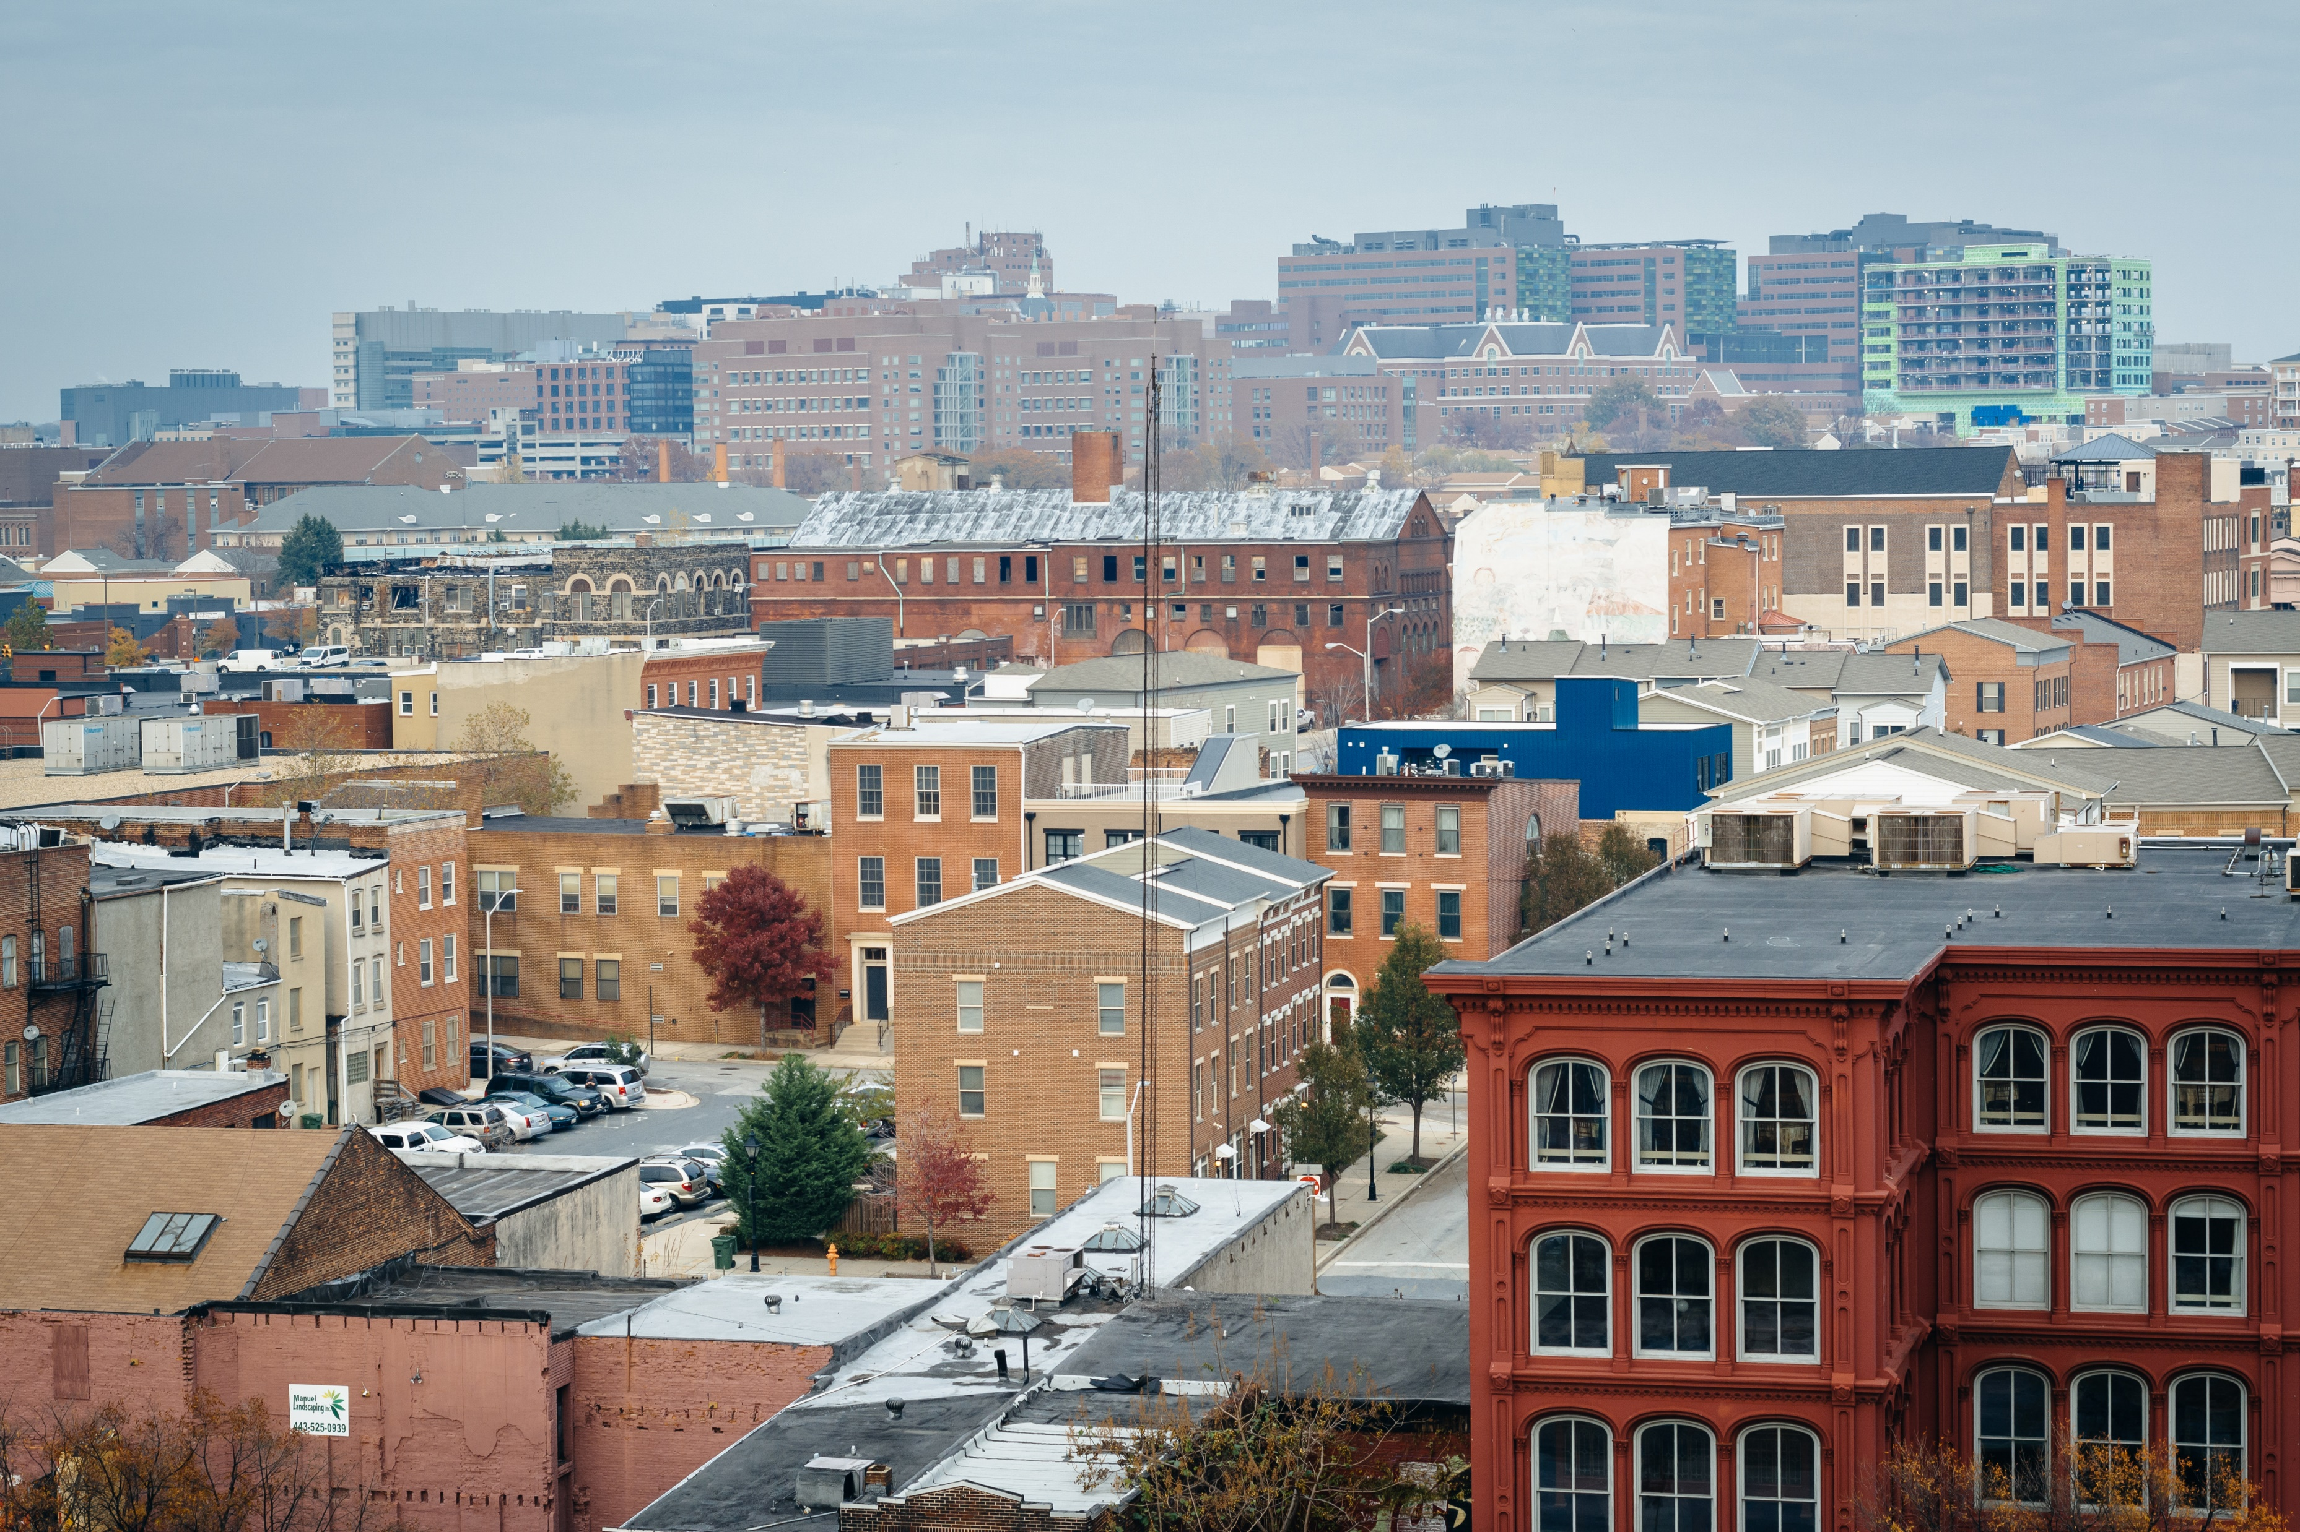
Housing Accelerator Program
Application Webinar
November 2, 2023
Notes:
Update

Slide 2
SCHEDULE
Public NOFA Announcement: 09/06/2023
NOFA Application Portal Opens: 10/20/2023
Pre-Proposal Conference: 09/14/2023
Application Questions Workshop: 11/02/2023
Application Submission Deadline: 11/20/2023
Awarding: December 2023
Notes:
*Update

Slide 3
INTRODUCTION
Through this Notice of Funding Availability (NOFA), the Baltimore City Department of Housing and Community Development (DHCD) is making up to $16 million available from the Housing Accelerator Fund (HAF) and up to $15 million available from the American Rescue Plan (ARP) for the HOME Investment Partnerships Program (HOME) to support the construction of Permanent Supportive Housing (PSH) for individuals and families who are homeless, at risk of homelessness, or in other vulnerable positions.
Subject to demand, affordable housing projects without PSH units will be considered for funding under this NOFA.

Slide 4
ELIGIBLE PROJECTS
Close financing gaps to allow potential projects with supportive housing units to proceed to development.
Secure set-asides of supportive housing units within housing projects already under development through equity investments.
Provide financing to develop new projects and enable their competition for other financing, through pre-development financing grants or loans

Slide 5
ELIGIBLE APPLICANTS
This NOFA is limited to applicants that are either a non-profit, for-profit or joint ventures that are seeking funds to create units accessible and dedicated for permanent supportive housing populations and other affordable housing projects.

Slide 6
MAYOR’S OFFICE OF HOMELESS SERVICES
Coordinated Access Overview
MOHS
NOVEMBER 2, 2023

Slide 7
Coordinated Access: Definition
What is Coordinated Access?
Coordinated Access is a centralized process for assessing persons in need of homeless services to determine the appropriate service type and housing option. It is a standard assessment process designed to assist in resolving the homelessness of those living in shelters, on the streets or in places not meant for human habitation.
The vision of the Coordinated Access System is to…
"ensure that individuals and families at risk of or experiencing homelessness, will have an equitable and centralized process for timely access to appropriate resources in a person-centered approach that preserves choice and dignity."
Coordinated Access is required by the U.S. Department of Housing and Urban Development for all Continuums of Care (CoC) as stated in 24CFR 578.7 (a)(8) of Continuum of Care Program Interim Rule.

Slide 8
Coordinated Access: Eligibility
What is the Eligibility Criteria?
Coordinated Access participating programs use only Category 1 and Category 4 for the purpose of determining eligibility.
Category 1 – Literally Homeless
Individual or family who lacks a fixed, regular and adequate nighttime residence, meaning:
Primary nighttime residence that is a public or private place not meant for human habitation
Living in a publicly or privately-operated shelter designed to provide temporary living arrangements
Exiting an institution where the individual resided for 90 days or less and who resided in an emergency shelter or place not meant for human habitation immediately before entering that institution
Category 4 – Fleeing/Attempting to Flee Domestic Violence
Any individual or family who:
Is fleeing or attempting to flee, domestic violence
Has no other residence; and
Lacks the resources or support network to obtain other permanent housing

Slide 9
Coordinated Access: System Workflow
What is the Coordinated Access System Workflow?
Step 1: Connecting to the Coordinated Access System
Applicants have access to the assessment at various points of entry within the homeless system.
Step 2: Assessment Phase
Trained Assessors complete the Coordinated Access Assessment.
Step 3: Navigation Phase
Applicants most likely to be matched are supported in gathering eligibility documents in preparation for a
housing offer
Step 4: Housing Match
CA matches applicants to housing opportunities based on the established system-wide prioritization standard. Applicants have 10 days to accept the housing match.
Step 5: Intake/Enrollment
Housing Program must follow up with the client matched to them through CA to begin the process for moving in.
Step 6: Inspections
An inspection of the property is required prior to the client moving in.
Step 7: Move-In
Once the client has been approved by the program and the unit passes the inspection, the client can move in!

Slide 10
Coordinated Access: Navigating Agencies
Where does someone go to complete a Coordinated Access assessment?
MOHS currently has over 28 navigating agencies throughout Baltimore City where individuals and families can go to access our system. These partner organizations are known as Navigating Agencies and include Emergency Shelters, Street Outreach Teams, Day Programs and Drop-in Centers. MOHS is currently seeking to add additional navigating agencies. A few of our agencies include:
Asociated Catholic Charities MOHS Outreach Team
Baltimore Crisis Response MOHS Housing Navigator Team
Baltimore Outreach Services MOHS HOPWA Team
Baltimore Safe Haven NuWave
Downtown Partnership of Baltimore Paul’s Place
For My Kidz, Inc. PASS Maryland
Health Care for the Homeless People Encouraging People
HEBCAC (The NEST) Project PLASE
Her Resiliency ROCA Inc.
HOPE Inc. Springboard Community Services
House of Ruth Maryland St. Vincent de Paul
Lifebridge (Grace Medical Center) TIME Organization
Loving Arms Youth Empowered Society
Marian House

Slide 11
Coordinated Access: Current Status/Match Average
How many applicants are currently in our system?
MOHS averages over 2,000 applicants seeking housing annually.
As of October 27, 2023, we have 1,575 clients, including those with pending housing offers including transfers.
How are vacancies filled?
Providers with housing vacancies report their vacancy to MOHS by completing the Coordinated Access Vacancy Reporting Form using the link below….
Coordinated Access Vacancy Reporting (google.com)
To ensure vacancies are filled as quickly as possible the CAS Workflow includes:
Regular touchpoints with Navigators to submit eligibility documents for clients most likely to be matched
Subpopulation bi-weekly case conferencing
Weekly matching with housing offer letters going out to applicants
Ongoing communication with Navigators and Providers to schedule initial intake appointments after acceptance of the housing offer

Slide 12
Continuum of Care (CoC)
The Baltimore City Continuum of Care (CoC) is a group of stakeholders that includes:
Government agencies
Service providers
People with lived experience of homelessness
Funders
Health and behavioral health systems
Advocates
And other stakeholders who are interested in making homelessness rare, brief and non-recurring
What is the role of the CoC?
The CoC is required by HUD to coordinate available resources and efforts
The Mayor's Office of Homeless Services (MOHS) serves as the collaborative applicant in partnership with the CoC
--> Sign up for the CoC listserv here: https://shorturl.at/jxU27

Slide 13
ELIGIBLE USES OF FUNDS
HOME-ARP funds are available to support the hard costs of eligible projects. Housing Accelerator funds are available to support both the hard and soft costs of eligible projects. Applications will be evaluated for eligibility under both HOME-ARP and Housing Accelerator funds. Applicants are encouraged to outline why one funding source may be more appropriate for their project than the other.
Eligible uses of funds include | Housing Accelerator Fund | HOME-ARP
Architectural and Engineering | X
Environmental assessment and testing | X
Acquisition | X
Market and Financial Feasibility Analysis | X
Carrying Costs | X
Zoning Analysis | X
Staff Time | X
Development consultants | X
Legal Fees associated with closing, financing, and drafting legal documents necessary for development | X
Development hard construction costs defined in 24 CFR 92.206(a) | X | X

Slide 14
INELIGIBLE USES OF FUNDS
Ineligible Uses
Acquisition of City-owned properties
Acquisition of properties through receivership
Acquisition of properties through tax sale
Staff that are not directly related to predevelopment, construction, or maintenance of the project general operating costs such as rent, utilities, or operating supplies
Relocation
Repayment of existing loans or liens
Community gardens or urban agriculture uses
Projects that support a specific religious or other affiliation
Commercial, retail, or economic development uses
Costs associated with the preparation of this NOFA submission

Slide 15
HOW TO APPLY
Only electronic submissions through the Neighborly application portal will be accepted. Applicants must submit one (1) complete online submission of their application.
Applications are due by 4:30 PM EST on 11/20/2023.
Notes:
Update

Slide 16
SUPPORTIVE HOUSING 101 PRESENTATION & Pre-Proposal Conference Webinar
CSH Supportive Housing 101 Webinar Link
https://www.youtube.com/watch?v=dVmUu6CMdQg&feature=youtu.be
Housing Accelerator Pre-Proposal conference presentation
Housing Accelerator Pre-Proposal Conference_KW PS Review.pptx (live.com)

Slide 17
CONTACT INFORMATION
Housing Accelerator Program Email Address:
housingacceleratorprogram@baltimorecity.gov

Slide 18
THANK YOU
@BmoreDhcd

