Slide 1
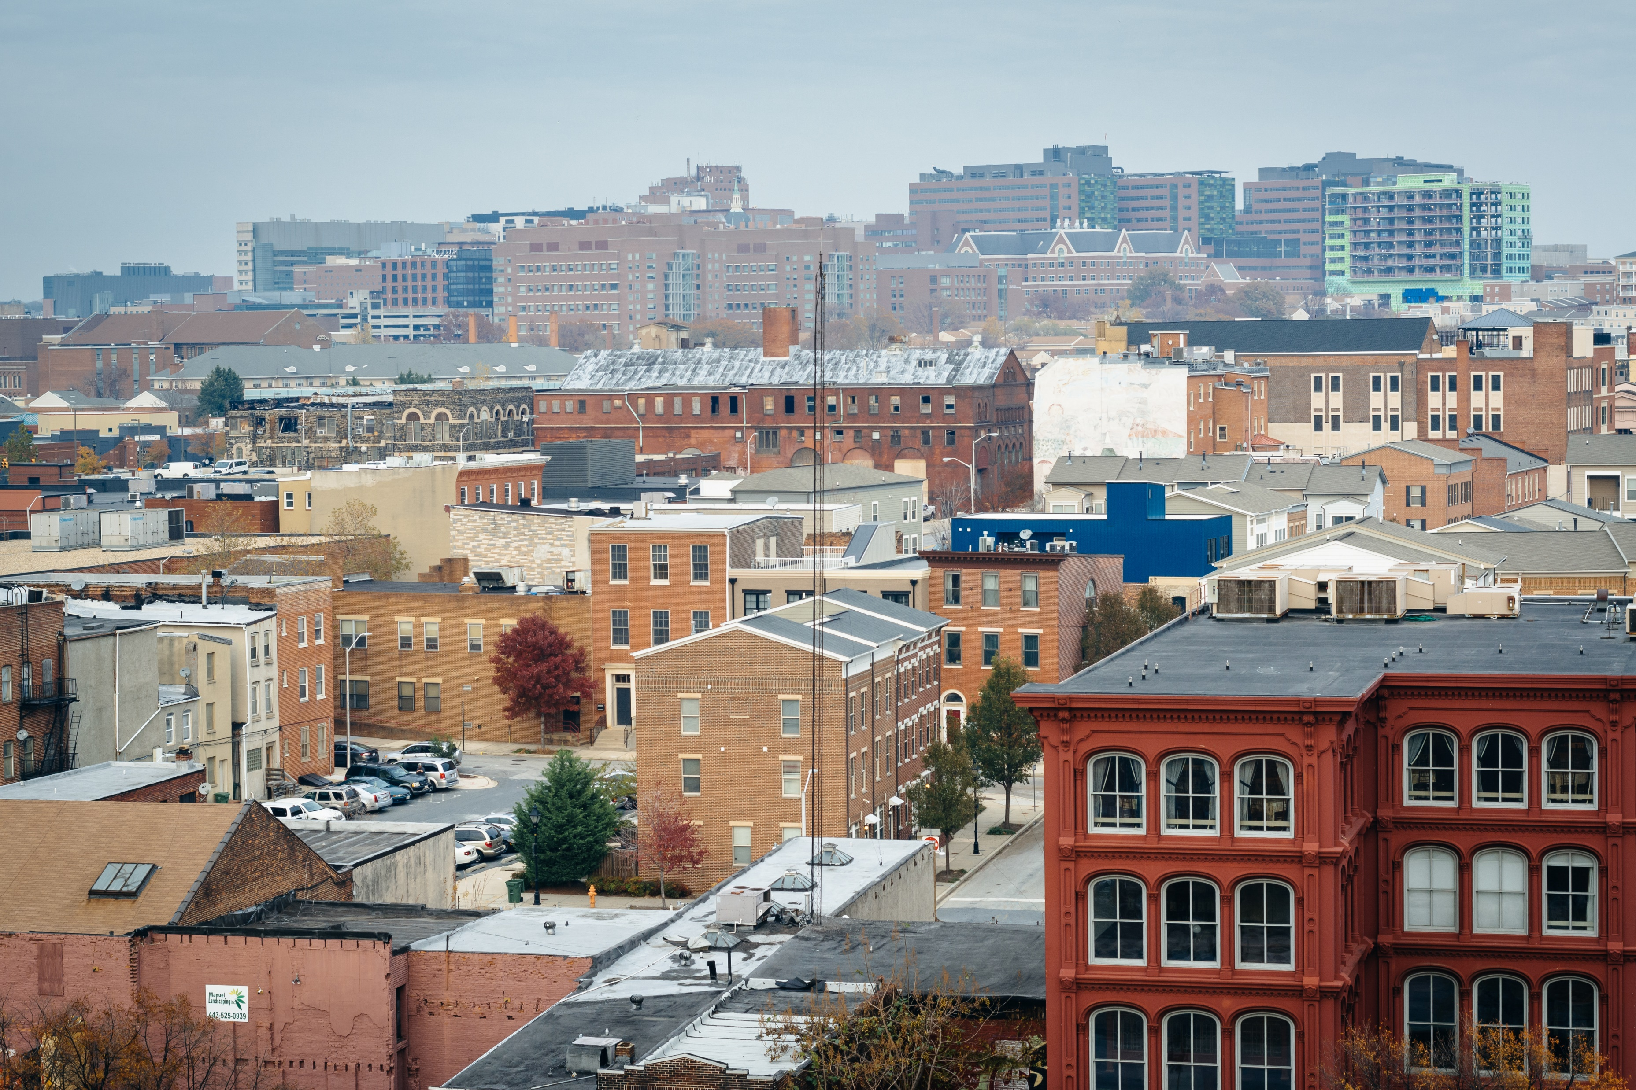
Developer Incentive Program
(Appraisal Gap Funding)
Pre-Proposal Conference
September 18, 2023
09/18/2023

Slide 2
SCHEDULE
NOFA Application Portal Opens: Week of September 18
Pre-Proposal Conference: 09/18/2023
Application Deadline: Rolling application until funds depleted

Slide 3
INTRODUCTION
DHCD established the Developer Incentive Program to provide appraisal gap funding to organizations, non-profits, and single-family primary homeowners who are in the process completing extensive renovation of formerly vacant homes located in one the city’s designated Impact Investment Areas for homeownership projects. Projects must have an appraisal gap due to total renovation cost exceeding the after-renovation market value.
The Developer Incentive Program will provide appraisal gap funding in the form of a grant. For Example: Renovation cost $200,000 and post rehab market appraised value is $150,000, leaving an appraisal gap of $50,000. The appraisal gap through the Developer Incentive Program will fill the appraisal gap

Slide 4
INTRODUCTION…CONT.
DHCD will be making up to $1.5 million in American Rescue Plan Act (ARPA) funding available for appraisal gap funds through the Developer Incentive Program. Each project is eligible to receive up to $50,000 in appraisal gap grant funding per property as justified by a certified property appraisal or recent broker price opinion and an accepted development pro forma and project budget.

Slide 5
ELIGIBLE APPLICANTS & PROJECTS
Eligible Applicants
Applicants eligible to apply for Developer Incentive Program appraisal gap funds includes for-profit developers, Non-Profits, and individual primary home-buyers seeking funds to eliminate expected appraisal gaps after the renovation of formally vacant properties in the city of Baltimore. Applicants may submit up to five (5) proposal per application in which the total subsidy does not exceed $250,000.
Eligible Projects
Single family projects for homeownership in Impact Investment Areas and prospective homeowners earning no more than 80% of the Baltimore City HUD AMI.

Slide 6
INELIGIBLE PROJECTS
Non-homeownership projects
Rental projects
Commercial projects
Properties outside of Impact Investment Areas
Properties without a vacant building notice
Homes for households earning over 80% of AMI

Slide 7
AFFORDABILITY RESTRICTIONS
All homes for purchase funded through the Developer Incentive Program must be for homebuyers that do not exceed 80% of the Area Median Income (AMI).

Slide 8
APPLICATION PROCESS
The application consists of four (4) parts:
application review
threshold requirements
financial review
signed certifications and authorizations

Slide 9
HOW TO APPLY
Only electronic submissions through the Neighborly application portal will be accepted.
Applicants can apply when projects are ready with financing and evidence of site control. Applications will be available on a rolling basis until total funding allocation is met. By submitting this application, you agree for DHCD to perform background check.

Slide 10
Completing the Online Neighborly Application for City Grants

Slide 11
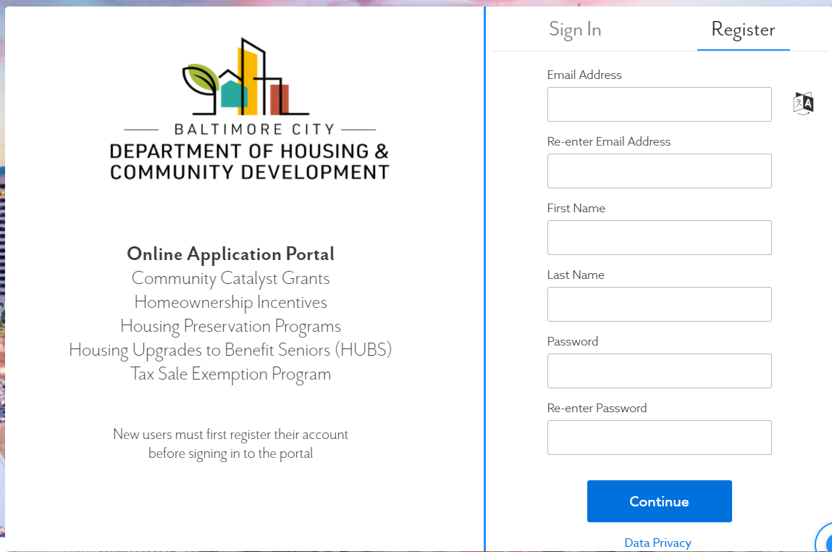
Click here to register
Register Your Account and Sign In
Navigate to https://portal.neighborlysoftware.com/baltimoremd/Participant#
Notes:
Navigate to https://portal.neighborlysoftware.com/baltimoremd/Participant# to begin your application.
If you do not yet have a Neighborly account, please “register,” then verify your e-mail address to log in.
_________________________________________________________
For a more in-depth walkthrough of completing the CCG Capital application, please visit https://www.youtube.com/watch?v=4tdxRJf_n0A for a video tutorial.

Slide 12
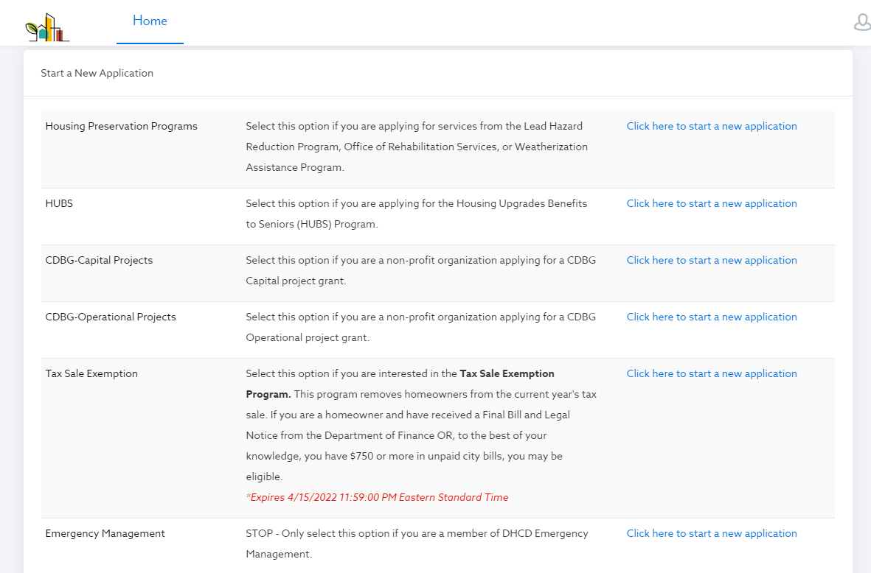
Start a New Application
Notes:
From your participant home page, scroll down to the list of possible applications you may submit. Locate the program you want to apply for and then select “click here to start a new application.”

Slide 13
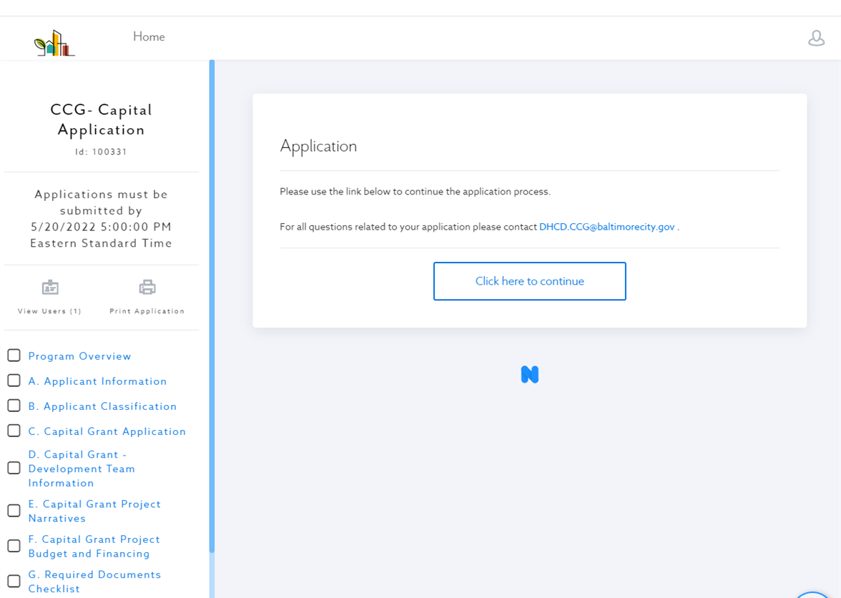
Click “Home” at any time to go back to your Participant Home Page
Navigating the Application
Use this button to view or add users to your app.
Use this button to print your app.
Use this sidebar to navigate to different sections of the application
Notes:
Once you have begun your application, you will see a sidebar on the left which will be your key navigation tool.
Click “View Users” to see the e-mail accounts associated with your application. Here, you can add additional users to give them access to view and edit the application.
Click “Print Application” to print or save a PDF of your full application.
Use the left side bar to navigate between different pages of the application. A green check mark will appear in the boxes next to application pages when they have been completed to provide you a visual cue of what you have and have not finished.

Slide 14
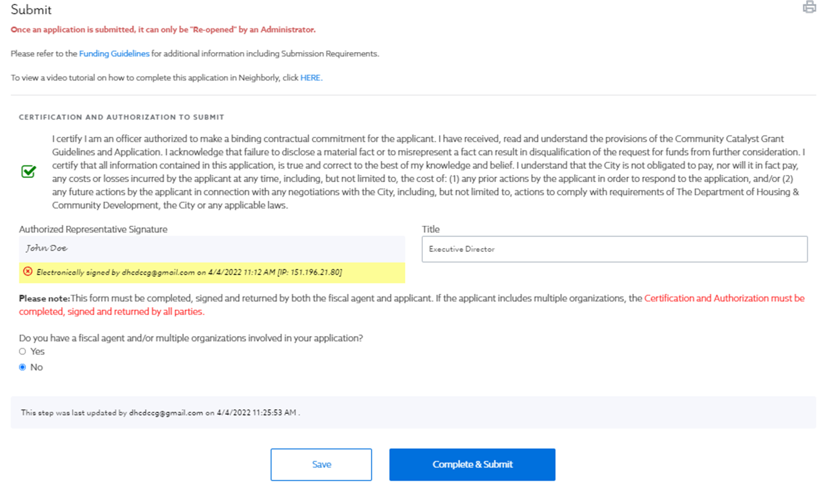
Once submitted, only an administrator can “re-open” the application.
Submit
SAVE when you want to come back later.
SUBMIT when your application is complete.
Notes:
Please only SUBMIT your application when it is complete and ready for review. Once submitted, you cannot make further changes, and only an administrator can re-open your application.
When ready, hit “Complete and Submit.”

Slide 15
Click here to VIEW or EDIT your application.
Check the status of your application.
Locating your application
Notes:
To locate your in-progress or submitted application, log in to your Participant Portal. You will see the STATUS of your application, as well as a link to view or edit your application.
_________________________________________________________

Slide 16
REQUIRED DOCUMENTS
Provide documentation of all funding sources
Project Budget and Project Scope of Work
Project Schedule
Attach Appraisal
Attach Marketing Plan, if applicable
Attach Vacant Property Notice
Provide evidence of site control or evidence of the ability to acquire the proposed site within three months of a funding award (example of site control include but not limited to, Exclusive Negotiating Privilege (ENP), Option, Contract of Sale)

Slide 17
THRESHOLD REVIEW
Before awarding, all applications must meet the following threshold criteria:
■ Proof of vacant building notice
■ Provide evidence of site control or evidence of the ability to acquire the proposed
site within three months of a funding award (example of site control include but
not limited to, Exclusive Negotiating Privilege (ENP), Option, Contract of Sale)
■ Homeownership for households that earn no more than 80% of HUD AMI
■ Estimated total project budget and project description (Note: Developer fee
cannot exceed 12% of total development cost)
■ Provide cash flow proforma
■ Ability to provide an as completed appraisal of the property
■ Proof of an appraisal gap based on provided project budget, sales price, and value
documentation
■ No vacant building notice in excess of projects related to the application
■ No outstanding liens or judgments on any properties (individual or organizations)
■ For organizations: Good Standing with State of Maryland

Slide 18
REVIEWING AND AWARDING FUNDS
All sellers will be required to show a use and occupancy permit before awarding.
DHCD will review all final home sale prices. If sale price is higher than appraisal value, DHCD will work with the seller to determine the next course of action.

Slide 19
AWARDING
Complete and sign award letter accepting the Developer Incentive Program funds
Sign executed grant agreement
Provide DHCD with income certification documentation of prospective homebuyers
Provide DHCD with homeowner closing documentation
Proof of sale to home-buyer is an arm’s length transaction
Home-buyer must provide an affidavit that certifies they will live in home as
primary residence for a minimum of five years
Current document showing appraised value of property
Use and Occupancy Permit will be required

Slide 20
UNDERWRITING AND AVAILIABILITY OF FUNDS
Funds will be awarded in the form of a grant.
All awardees must sign the BOE approved grant agreement.
Once grant agreement is signed and grant funding conditions are met, the grantee will receive payment.

Slide 21
MONITORING, COMPLIANCE, AND REPORTING
Homebuyers will be required to sign an affidavit at purchase attesting to their intent to occupy the home themselves for 5 years after purchase. The owner-occupancy requirement is enforceable through penalty of perjury.
Seller will be required to show proof home was sold to households earning no more than 80% of AMI.
DHCD will review all final home sale prices. If sale price is higher than appraisal value, DHCD will work with the seller to determine the next course of action.

Slide 22
INSURANCE
All awardees will be required to provide evidence of insurance prior to DHCD’s issuing a letter of commitment. Insurance requirements will be provided on a project basis and often include the following:
Directors and Officers Liability Insurance
Commercial General Liability
Errors and Omissions (Consultants)
Blanket Crime Coverage
Automobile Coverage
Payment and Performance Bonds

Slide 23
MISCELLANEOUS
Incurring Expenses
Neither the City of Baltimore nor DHCD will be responsible for any cost incurred by any applicant in preparing and submitting an application in response to this NOFA.
Compliance with Law
By submitting an application, applicants agree that they will comply with all Federal, State and City laws, rules, and regulations and ordinances applicable to its activities and obligations under this program.
Public Information Act Notice
DHCD commits to handling all information regarding financial assets in strictest confidence. Applicants should give specific attention to identifying any portions of their application that they deem to be confidential, proprietary or trade secrets and provide justification why such material should not be disclosed by DHCD under the Maryland Public Information Act SS 1-601 et seq. of the State Government Article, Annotated Code of Maryland upon request by the public.

Slide 24
CONTACT INFORMATION
Developer Incentive Program Email:
developerincentiveprogram@baltimorecity.gov

Slide 25
THANKS!
@BmoreDhcd

