Slide 1
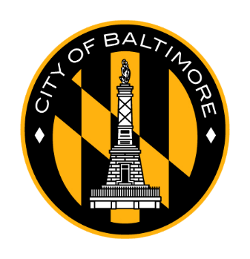
Community
Conversations
Mayor’s Office, DHCD, DOP
Thursday, June 20, 2023
Baltimore, City

Slide 2
AGENDA
Part 1:
Welcome & Introductions
Statement of Occasion
Part 2:
IIA Park Heights Overview
Project Tracker Overview
Part 3:
Neighborhood Discussion Exercise Overview
Neighborhood Discussion Exercise
Part 4:
Wrap Up & Next Steps

Slide 3
Welcome
Introductions & Occasion
Mayor’s Office, DHCD, DOP
DHCD.Baltimorecity.gov

Slide 4
WELCOME REMARKS
Asst Commissioner Tamara Woods – DHCD
Commissioner Alice Kennedy – DHCD

Slide 5
Neighborhood Subcabinet/Working Groups/Community Conversations Structure
Executive level prioritization, oversight and resource alignment
Neighborhood Subcabinet
Mayor
Deputy Mayors
Agency Heads
Working Group
(7) Impact Investment Areas
Neighborhood Development Officers
City Planners
Councilmembers
Community Development Organizations
Neighborhood Associations
Agency level planning and implementation with neighborhood partners
Community level information-sharing and general feedback
Community Conversation
City Agencies
General Public
Neighborhood Stakeholders
Notes:
Alice Slide

Slide 6
Newest Vacants Tool: In-Rem Acquisition
Eligible Properties: Liens must exceed value of property
Circuit Court Docket
Only jurisdiction in Maryland with this acquisition opportunity
General Information
Expected acquisition timeline: 4 – 11 months
Do not have to wait for issuance of tax certificate/ auction not necessary
City will have full authority to sell the property
Community Engagement
Communities can submit addresses of vacant properties for Development Division to review for in rem tax lien foreclosure eligibility here
Publicly available fact sheet

Slide 7
Park Heights IIA
Implementation Strategy Overview
Mayor’s Office, DHCD, DOP
DHCD.Baltimorecity.gov

Slide 8
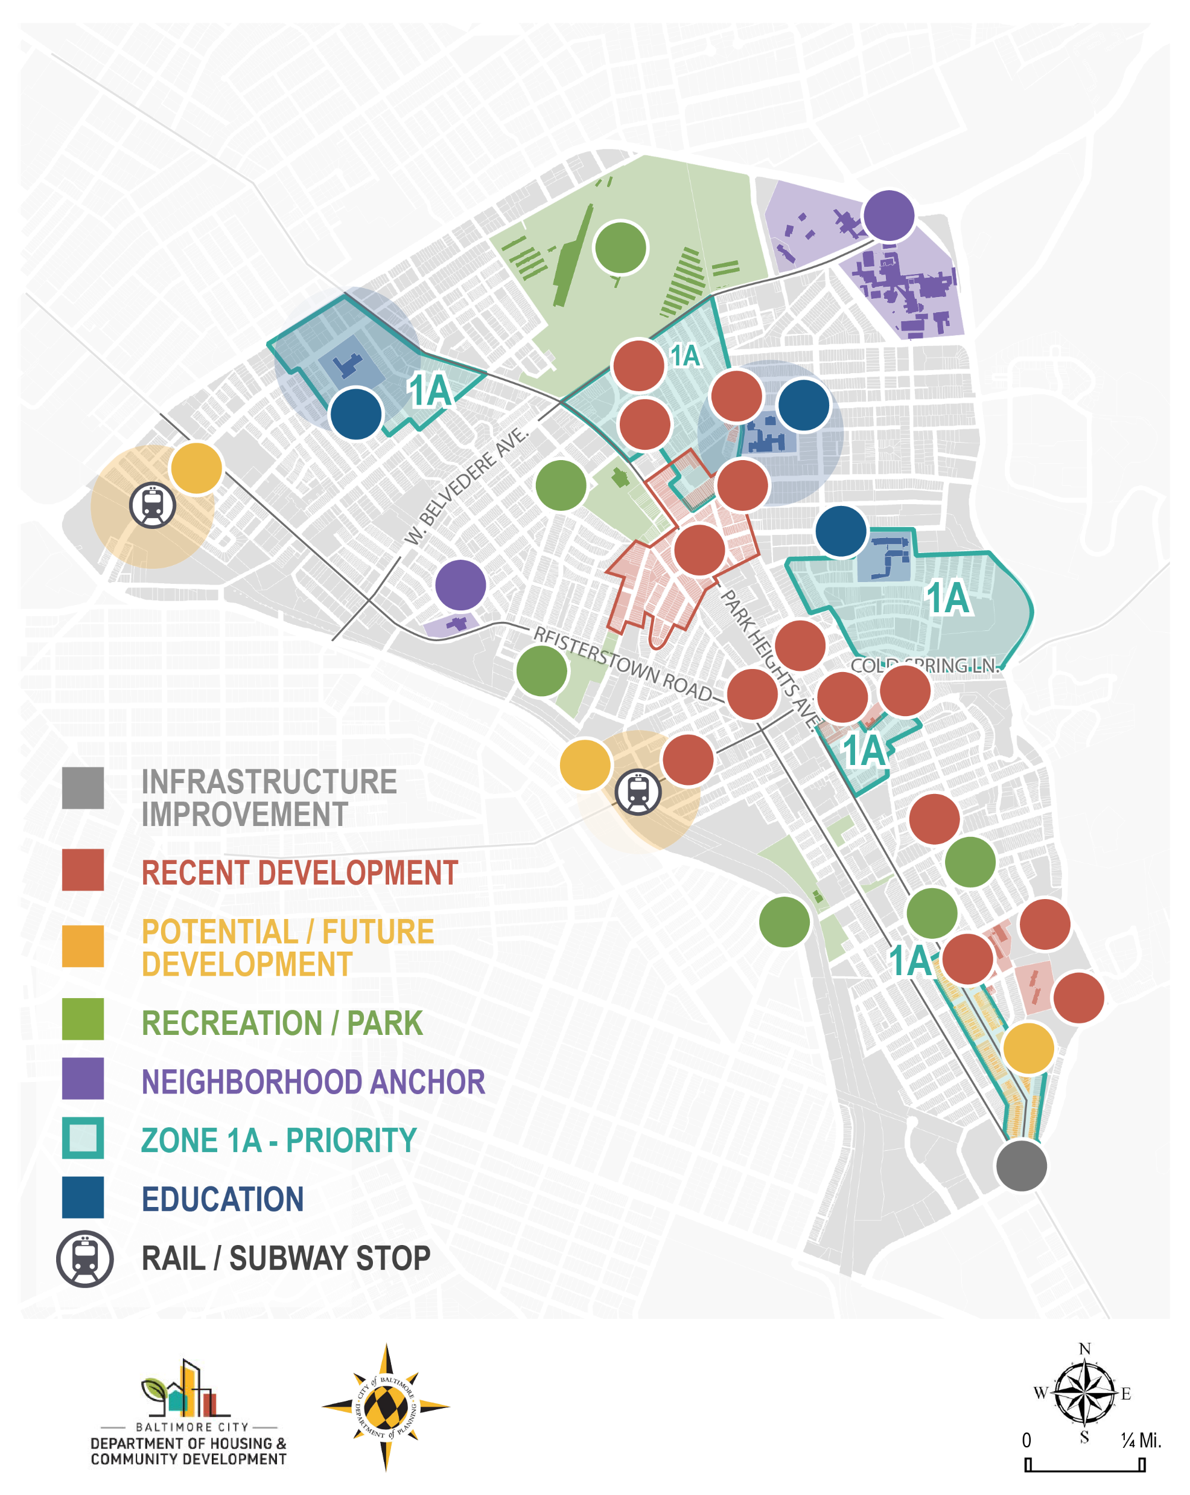
Building From Strength
Notes:
The IIAs were first identified in the 2019 DHCD Community Development Framework
They are areas of the City that are poised for transformational revitalization at the neighborhood level based on their existing assets, current redevelopment activity, and proximity to already shifting markets.
The Park Heights IIA is a wealth of diverse neighborhoods and corridors. It’s character is rich with a variety of early 19th and 20th century porch front rowhomes and single-family houses, multi-family senior and affordable housing etc. There are so many assets to build from Park Heights including:
Pimlico Racecourse
Sinai Hospital
New 21st Centure Schools
State of the art rec centers
A (soon to be) brand new library!
The theory of the IIAs is that we can build from these strengths to revitalize these communities with concentrated investment, coordinated deployment of city services and resources, and by working directly with neighborhood residents and stakeholders to develop databased implementation strategies.
We have been working with community partners and Park Heights Renaissance, to compile these strategies, identify priorities, and seeking funding for implementation. This has resulted in the Implementation Strategy document that was shared online and that we will be discussing today.
Our goal today is to broaden the conversation by sharing this work with a larger audience and get feedback to help finalize the document.

Slide 9
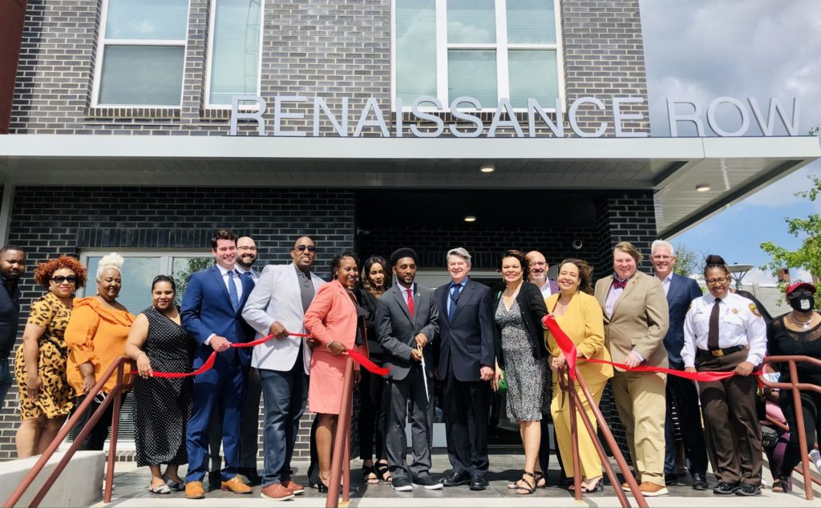
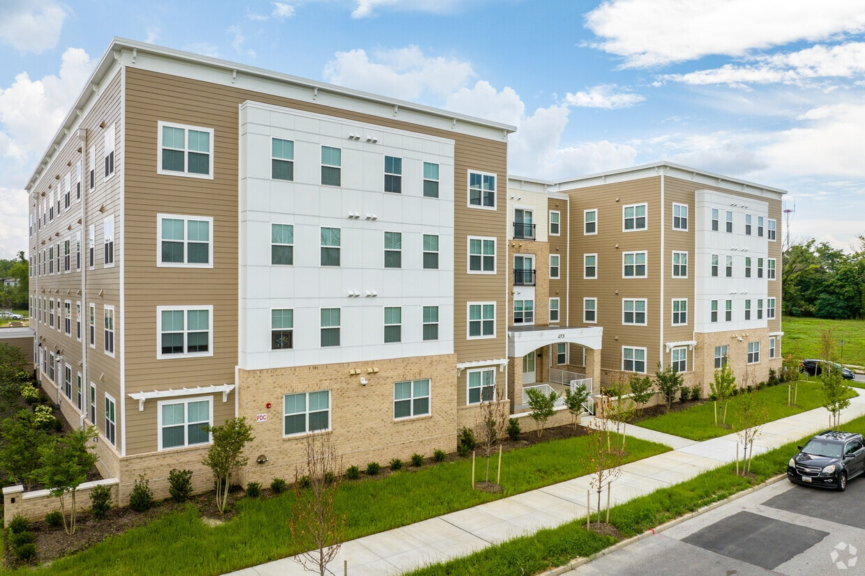
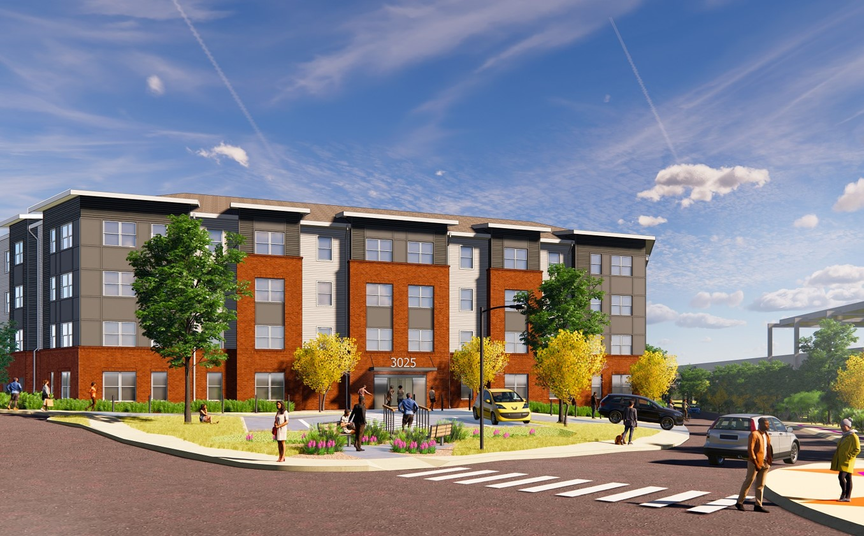
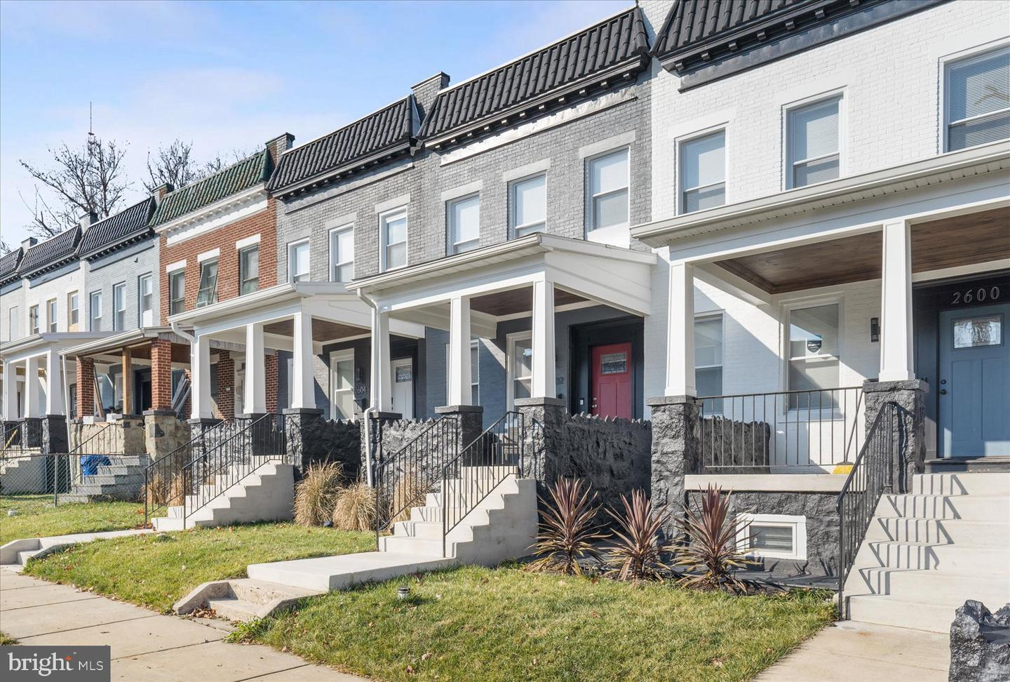
Building from Strength
Woodland Gardens I & II
Renaissance Row
Cold Spring TOD
Center for Hope
Loyola Northway
Notes:
The IIAs were first identified in the 2019 DHCD Community Development Framework
They are areas of the City that are poised for transformational revitalization at the neighborhood level based on their existing assets, current redevelopment activity, and proximity to already shifting markets.
The Park Heights IIA is a wealth of diverse neighborhoods and corridors. It’s character is rich with a variety of early 19th and 20th century porch front rowhomes and single-family houses, multi-family senior and affordable housing etc. There are so many assets to build from Park Heights including:
Pimlico Racecourse
Sinai Hospital
New 21st Centure Schools
State of the art rec centers
A (soon to be) brand new library!
The theory of the IIAs is that we can build from these strengths to revitalize these communities with concentrated investment, coordinated deployment of city services and resources, and by working directly with neighborhood residents and stakeholders to develop databased implementation strategies.
We have been working with community partners and Park Heights Renaissance, to compile these strategies, identify priorities, and seeking funding for implementation. This has resulted in the Implementation Strategy document that was shared online and that we will be discussing today.
Our goal today is to broaden the conversation by sharing this work with a larger audience and get feedback to help finalize the document.

Slide 10
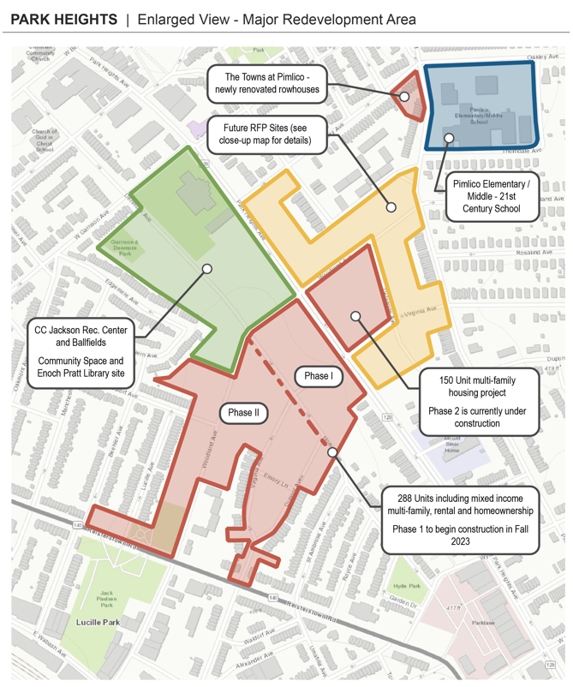
Building From Strength
Notes:
The IIAs were first identified in the 2019 DHCD Community Development Framework
They are areas of the City that are poised for transformational revitalization at the neighborhood level based on their existing assets, current redevelopment activity, and proximity to already shifting markets.
The Park Heights IIA is a wealth of diverse neighborhoods and corridors. It’s character is rich with a variety of early 19th and 20th century porch front rowhomes and single-family houses, multi-family senior and affordable housing etc. There are so many assets to build from Park Heights including:
Pimlico Racecourse
Sinai Hospital
New 21st Centure Schools
State of the art rec centers
A (soon to be) brand new library!
The theory of the IIAs is that we can build from these strengths to revitalize these communities with concentrated investment, coordinated deployment of city services and resources, and by working directly with neighborhood residents and stakeholders to develop databased implementation strategies.
We have been working with community partners and Park Heights Renaissance, to compile these strategies, identify priorities, and seeking funding for implementation. This has resulted in the Implementation Strategy document that was shared online and that we will be discussing today.
Our goal today is to broaden the conversation by sharing this work with a larger audience and get feedback to help finalize the document.

Slide 11
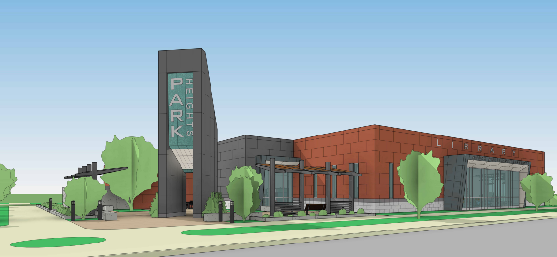
Park Heights Library

Slide 12
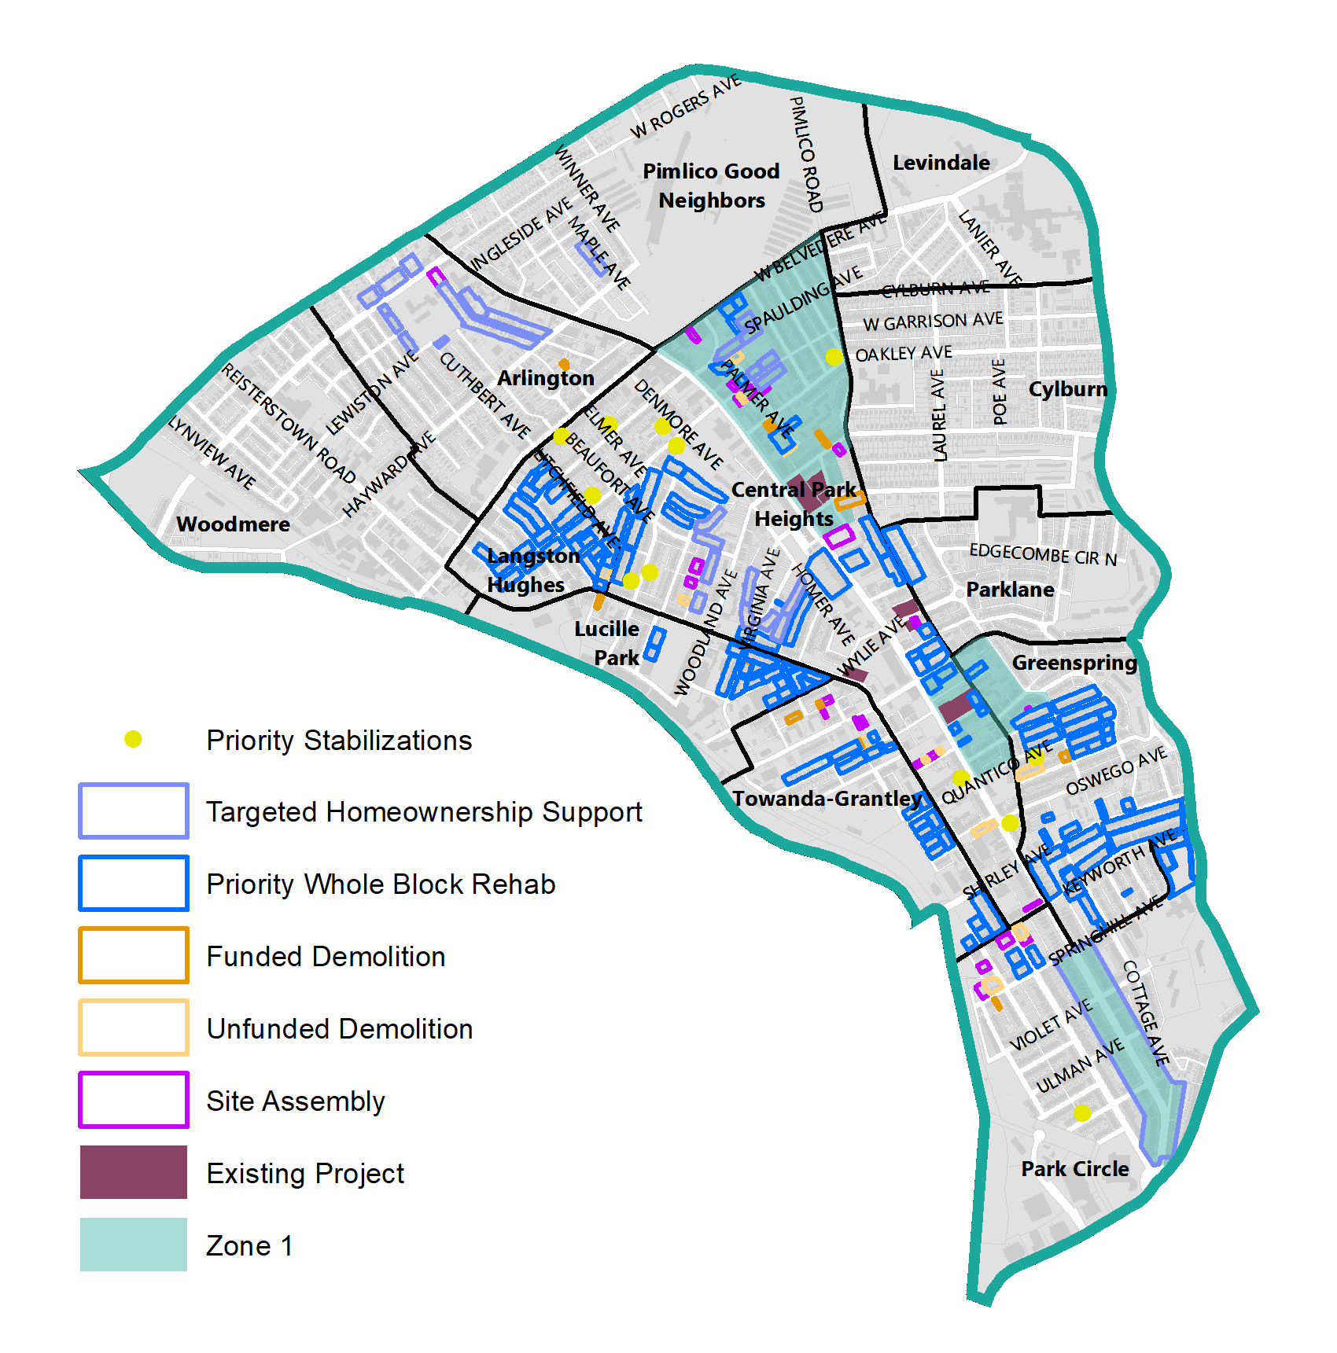
Block Level Planning
Targeted Homeownership Support
Priority Site Assembly and Whole Block Rehab
Demolition and Stabilization
Notes:
Homeownership: Portions of every neighborhood in Park Heights, have received funding for Homeowner Repair Grants targeted to legacy homeowners who need repairs to their homes.
Priority Site Assembly: MRA, Loyola Northway, Zone 1 areas
Demolition and Stabilization: MRA, Stabilization along Park Circle
Community Development/IIA Zones
Define Zones – Connect project tracker, and talk about how we came to these zones
Guides spending, ARPA, etc. - Introduce, tools and Renovation, rehab and acquisition, stabilization, vacancy working group stuff. Specific tools that use, and ARPA.

Slide 13
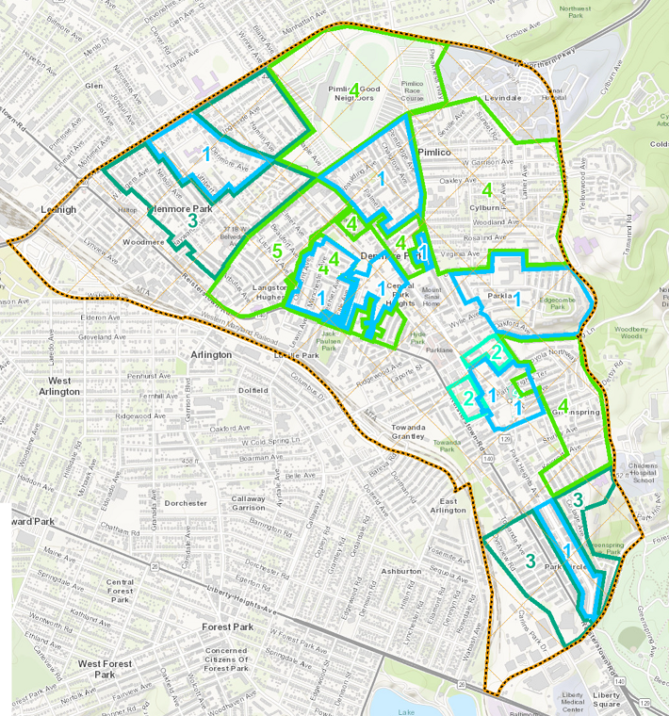
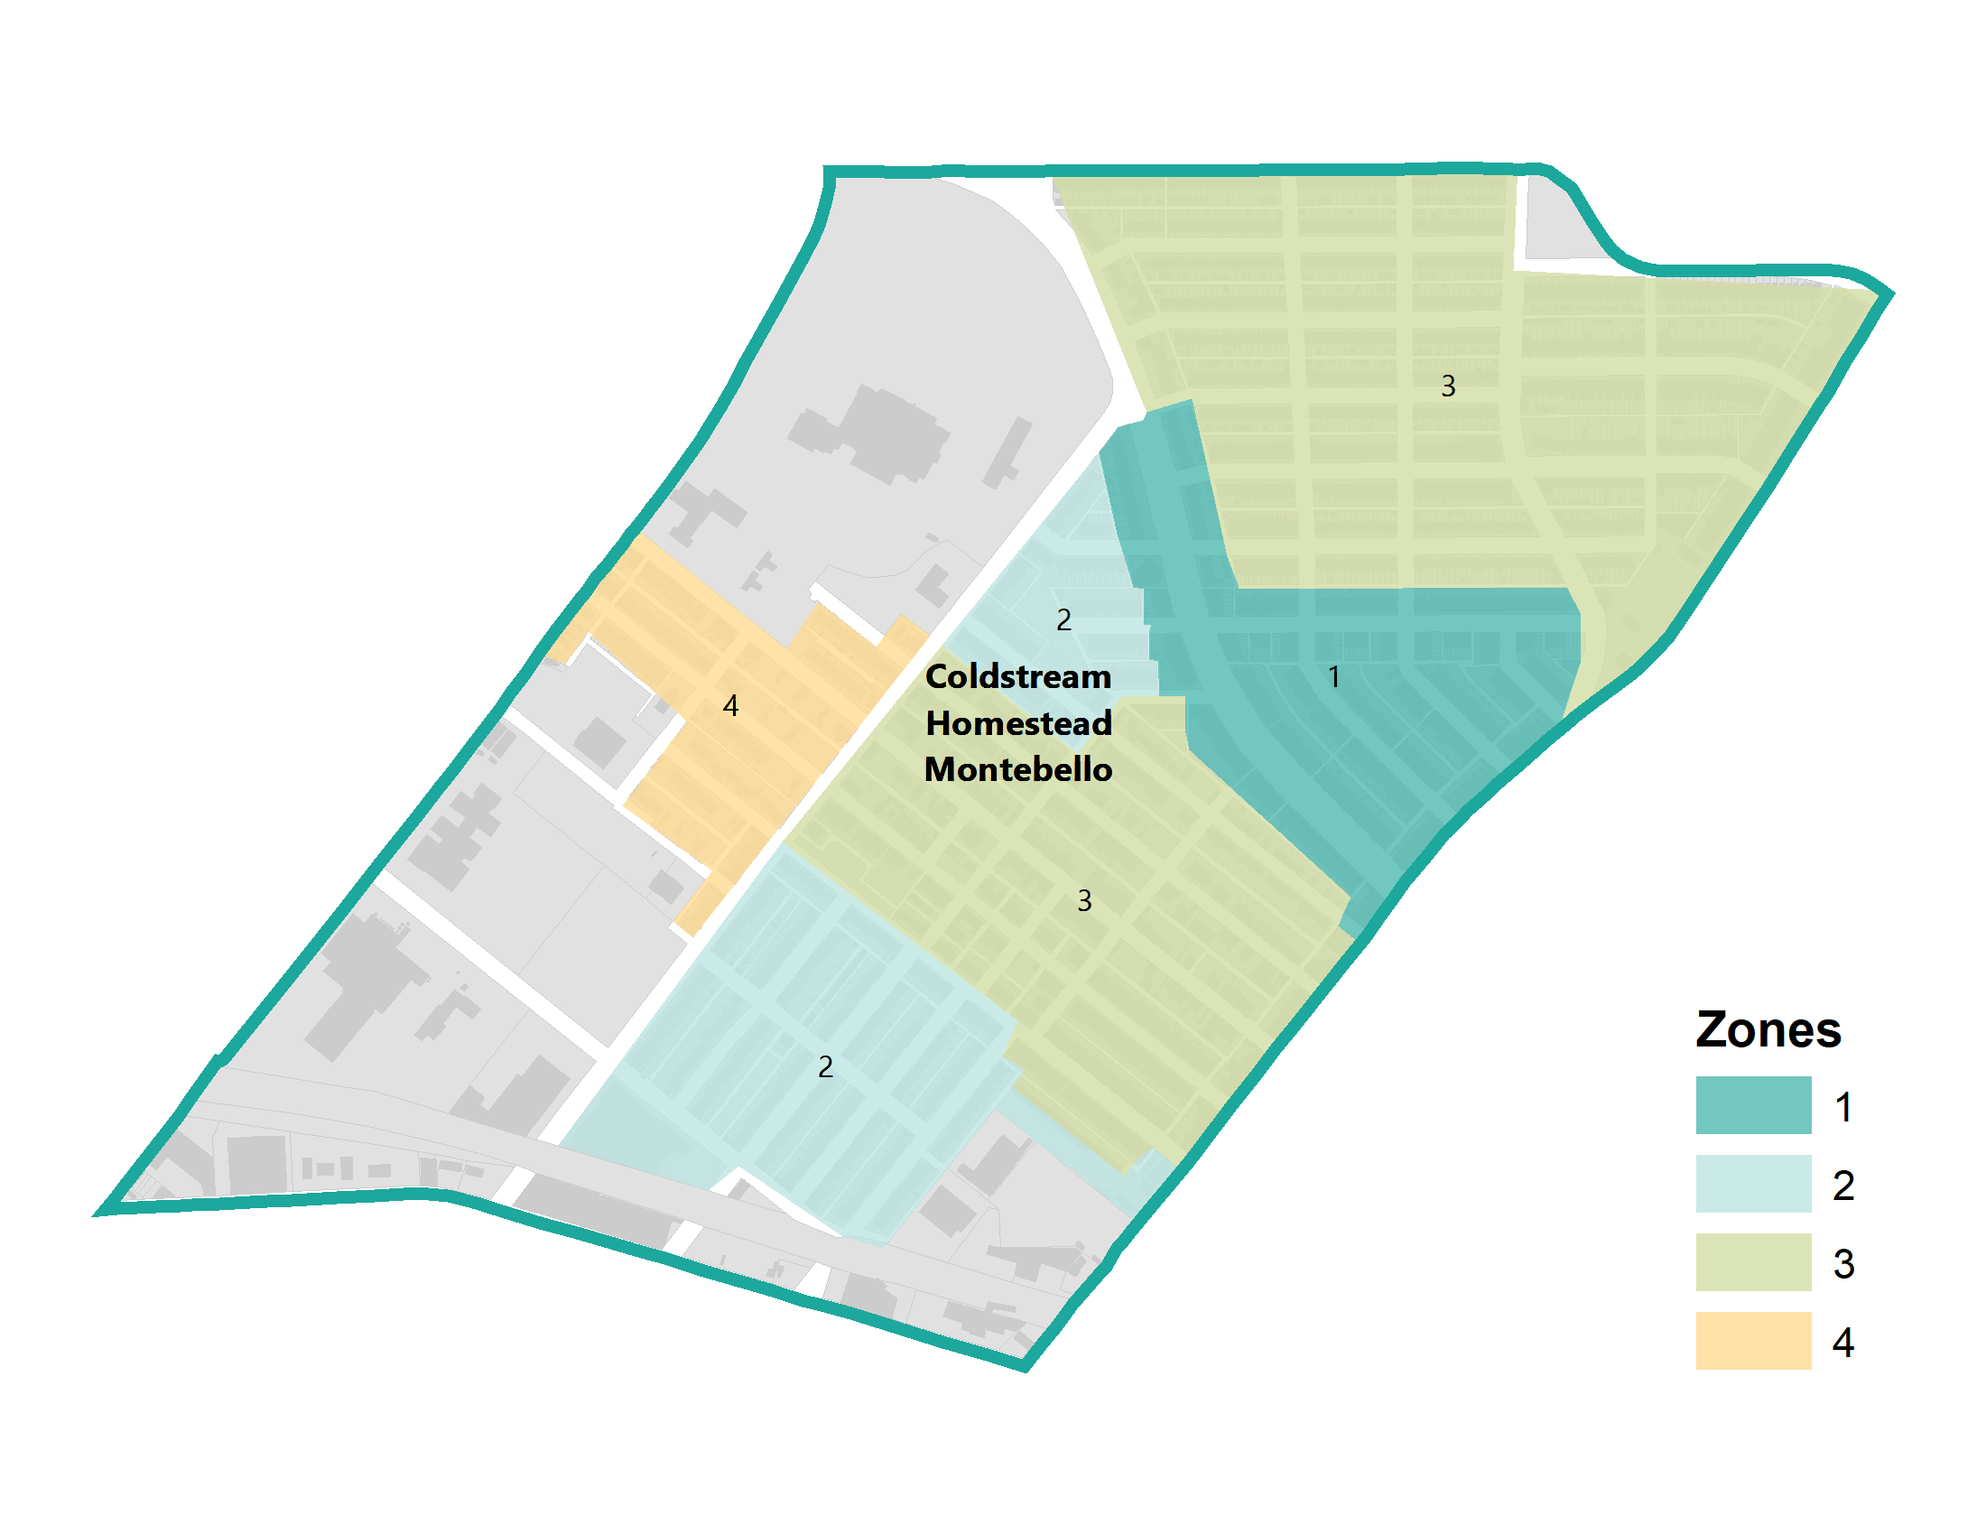
Community Development Zones (CDZ)
Ongoing projects related to development
Focus on homeownership, new construction and/or rehab of vacant homes
Notes:
Define Zones – Connect project tracker, and talk about how we came to these zones
Guides spending, ARPA, etc. - Introduce, tools and Renovation, rehab and acquisition, stabilization, vacancy working group stuff. Specific tools that use, and ARPA.

Slide 14
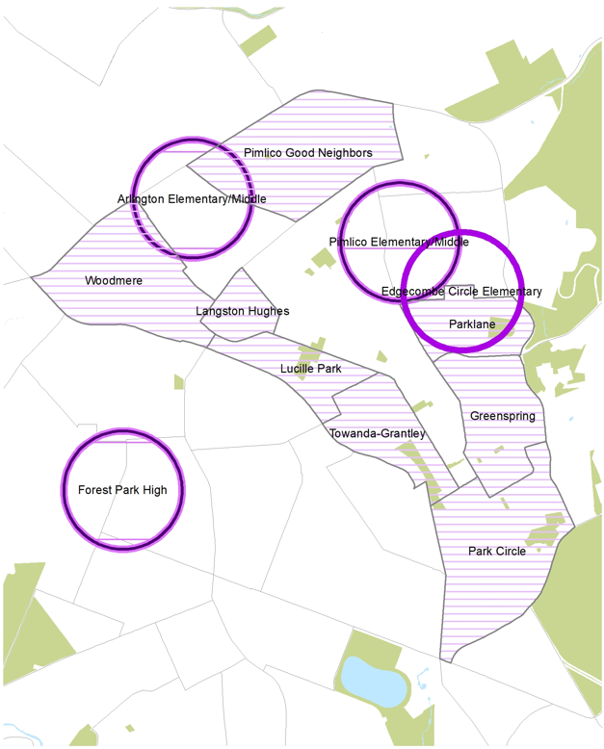
Homeownership Support
Housing and Rehabilitation Repairs
Weatherization
Lead Hazard Reduction
Tax Sale Prevention
Grants to support home buyers and businesses.
Notes:
Housing Rehabilitation and Repairs: The Office of Homeownership initiates the repair process that addresses emergencies, code violations, and health and safety issues for owner-occupied properties. Available only for eligible owner-occupied properties.
Weatherization: The Office of Homeownership initiates the process for energy efficiency improvements that lower utility bills and make homes safer and more comfortable. Available for eligible owner-and tenant-occupied properties.
Lead Hazard Reduction: The Office of Homeownership manages lead remediation projects for eligible owner- and tenant-occupied properties. Household must include a pregnant woman or a child under 6. Available for eligible owner-and tenant-occupied properties.
Tax Sale Prevention: DHCD’s Tax Sale Services Coordination and Prevention division assists homeowners in avoiding tax sale and in understanding and navigating the tax sale process
Grants: Live Near Your Work, Live Baltimore Grant, CDBG, Vacants to Value booster and Façade Improvements.

Slide 15
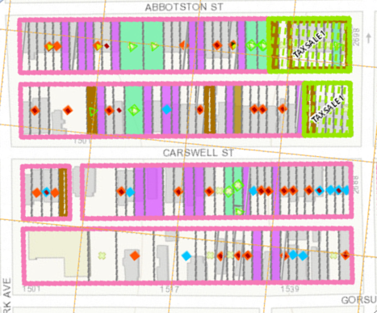
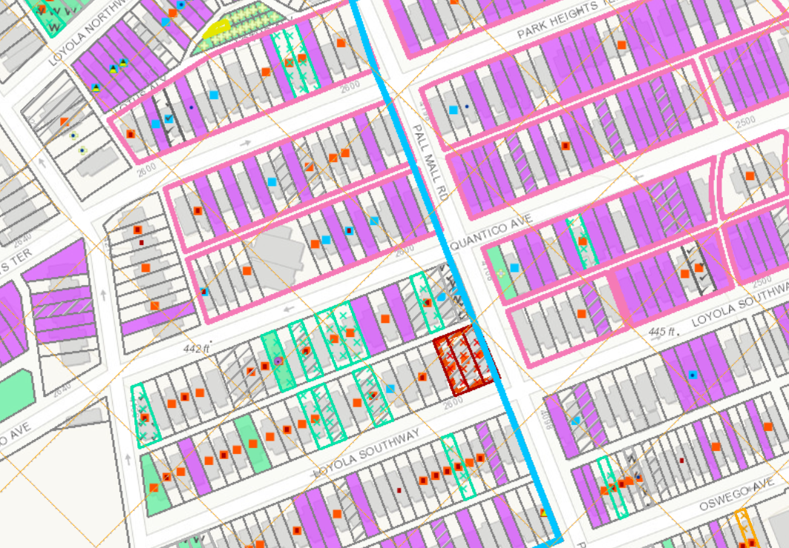
Rehab Toolkit
Support for Homeowners
Priority Stabilization
Receivership
Acquisition via In Rem and Condemnation
Notes:
Homeowner Supports: As discussed above, support for legacy homeowners in Impact Investment Areas, with a focus on Community Development Clusters as possible, is a critical strategy to ensure existing residents benefit as neighborhood’s improve.
Stabilization: Many buildings are in the middle of stable and resilient blocks and so, demolition would require further substantial construction. Additionally, Baltimore is home to many unique and beautiful buildings. Stabilization would preserve their inherent value for future use.
Receivership: Receivership has accounted for hundreds of vacant building rehabs in the city and Baltimore is nationally-recognized as a leader in the practice.
Acquisition through Tax Sale Foreclosure and Condemnation: This provides the City significant leverage in supporting specific outcomes for the redevelopment of the property through a subsequent competitive bid process. This could include production of affordable units and/or homeownership units. The City can also engage in Donations, Negotiated Sales, and Property Swaps as methods of property acquisition.

Slide 16
Project Tracker
Overview
Mayor’s Office, DHCD, DOP
DHCD.Baltimorecity.gov

Slide 17
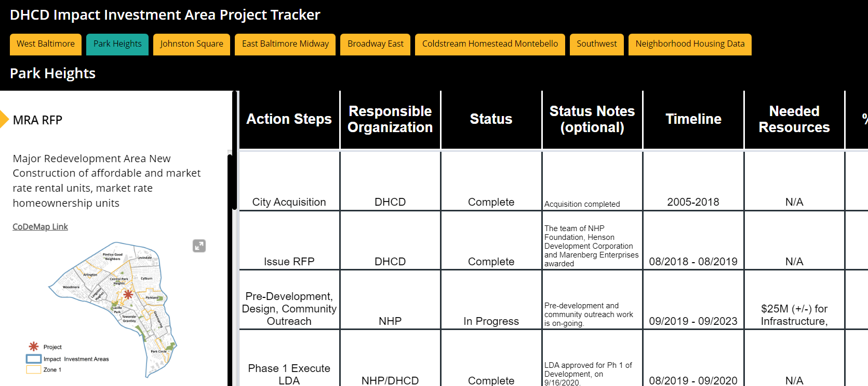
Project Tracker
From Theory to Practice: Introduction of DHCD’s IIA Project Tracker
Project Tracker || bit.ly/3cfg0xo || Kimberly.Rubens@baltimorecity.gov

Slide 18
Engagement Session
Mayor’s Office, DHCD, DOP
DHCD.Baltimorecity.gov

Slide 19
NEIGHBORHOOD DEVELOPMENT
What keeps you here in your neighborhood?
What do you need to see more or less of in order to continue to want to live in Park Heights?
FIRST DISCUSSION TOPIC
Notes:
In a few minutes we'll start our breakout discussions.
We know from the charrettes that your connections to your neighbors and your loved ones are part of what keeps folks here in Park Heights. What else? Is it transit? Is it affordable homeownership? Is it the new future library?
We also want to hear what you need to see more of or less of in order to continue to want to live here. We've heard a lot of folks say they want more retail? Well what kind and where? Are there areas of types of businesses that are oversaturated?
When you're in Park Heights, where do you spend most of your time when you're not at home, and why?

Slide 20
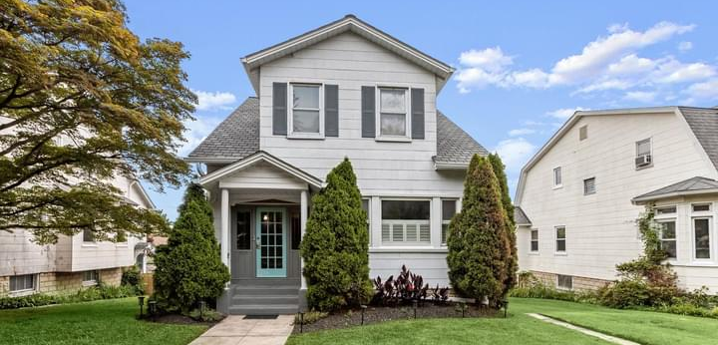
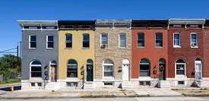
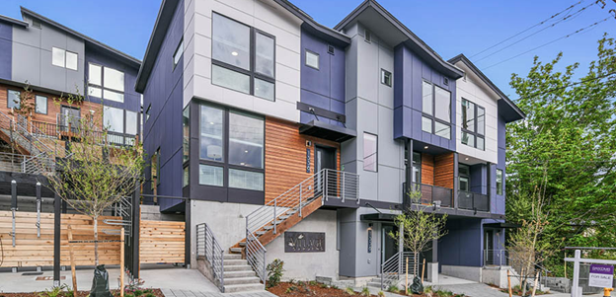
Single-Family Detached
Mixed-Use with Ground-Floor Retail
Historic Rowhomes
New Rowhomes
Notes:
We also want to hear more specifically about the types of housing you want to see more or less of and why.
Here are some examples that are also in your handouts: On the right we see a mixed-use building with retail on the bottom and housing on top.
The lower left shows classic historic-style rowhomes that may need some rehab, while the photo on the right shows some new construction townhome developments.

Slide 21
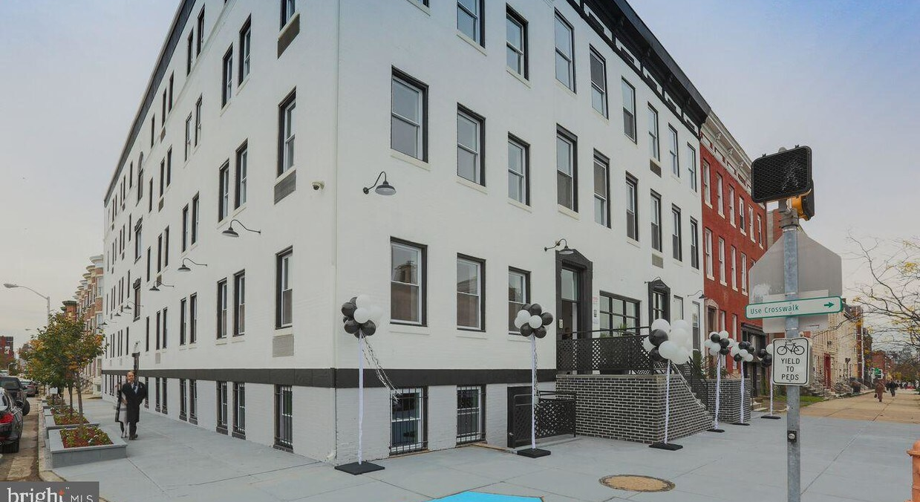
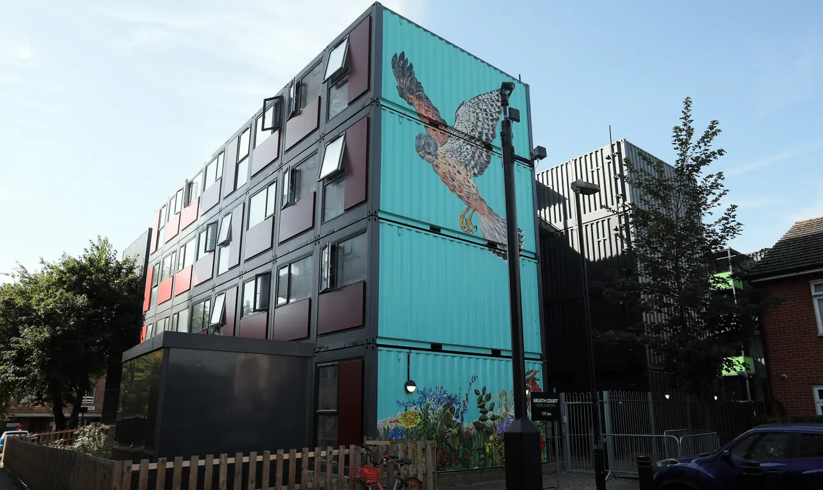
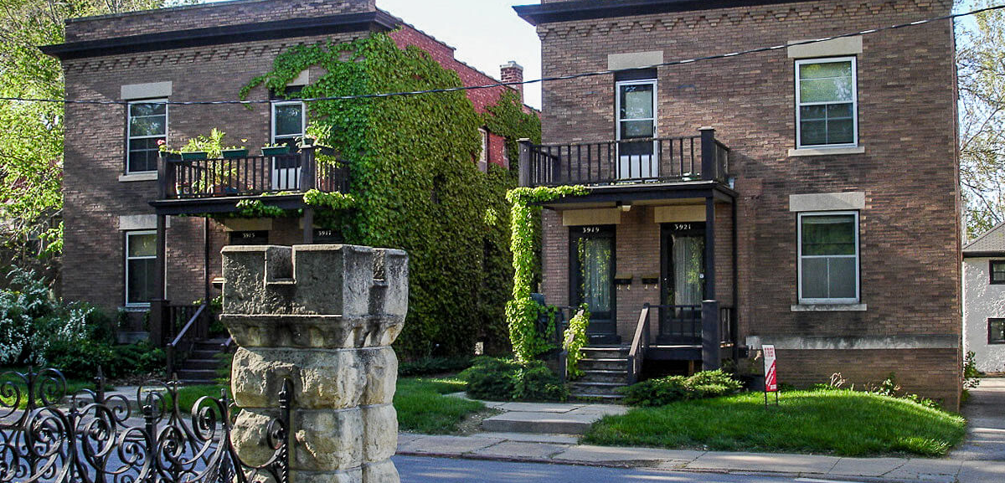
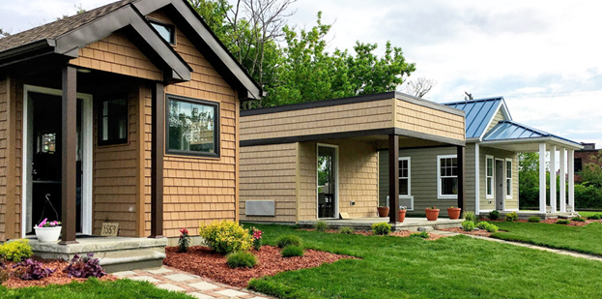
Condos/Apartments
Modular or Container Homes
Duplexes
Tiny Home Communities
Notes:
On this slide, we see an example of a multifamily building that could be an apartment or condos
Below that, we see a couple of stacked, two-family homes, which are also known as duplexes.
There are modular or container homes on the upper right. These come in a lot of different styles but are known for being more affordable to build and therefore more accessible to buy or rent.
And of course, we also have a standard single family home!

Slide 22
2. HOUSING DEVELOPMENT
Use the photos with examples of different housing types to discuss what you'd like to see more or less of in Park Heights and why.
Please also tell us if you are interested in different ownership structures, such as community land trusts, condos, co-ops, and so on.
SECOND
DISCUSSION TOPIC
Notes:
Our goal is to understand your priorities for development in the future of Park Heights.
Do you want to see more or less of these housing types, and what are your priorities? Does housing in Park Heights currently meet the needs of current and fu
Finally, as we break for the discussion, we just want to remind folks to be please be mindful of their participation. If you have a lot to say and are talking often, please consider stepping back to make room for others. And if you haven't said much, we encourage you to step up and contribute at least once so that we can try to hear from everybody.
At 7:45, we'll ask a leader from each group to share back one or two recommendations with the entire room.

Slide 23
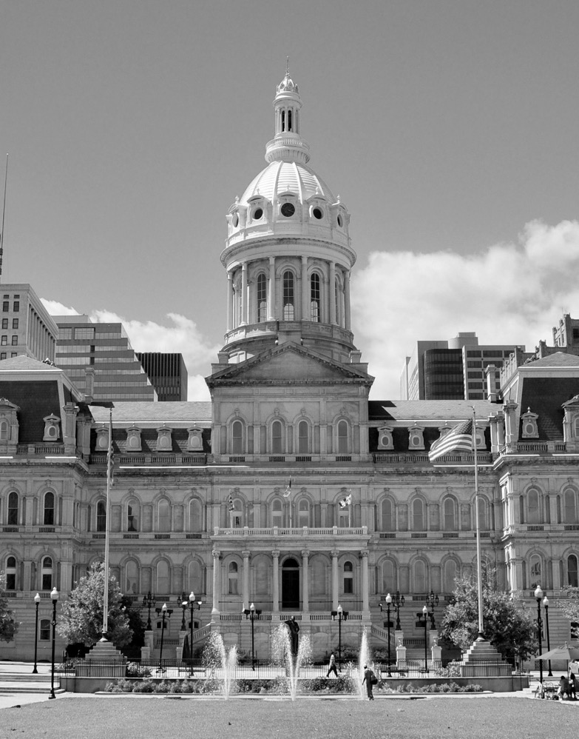
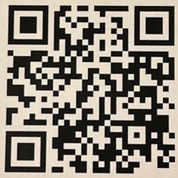
Next Steps and Closing
Online Survey
Next MNSC will be September 2023
Implementation Strategy (IS) Document and Project Tracker are now online for viewing.

Slide 24
Thank You!
Mayor’s Office, DHCD, DOP
DHCD.Baltimorecity.gov

