Slide 1
Community
Conversations
Mayor’s Office, DHCD, DOP
Wednesday, June 7, 2023
Baltimore, City

Slide 2
AGENDA
Part 1:
Welcome & Introductions
Statement of Occasion
Part 2:
IIA C.H.M. Overview
Project Tracker Overview
Part 3:
Neighborhood Discussion Exercise Overview
Neighborhood Discussion Exercise
Part 4:
Wrap Up & Next Steps

Slide 3
Welcome
Introductions & Occasion
Mayor’s Office, DHCD, DOP
DHCD.Baltimorecity.gov

Slide 4
WELCOME REMARKS
Asst Commissioner Tamara Woods – DHCD
Executive Director Mark Washington – C.H.M. Community Corporation
Director Chris Ryer - DoP
Commissioner Alice Kennedy - DHCD

Slide 5
Neighborhood Subcabinet/Working Groups/Community Conversations Structure
 | NEIGHBORHOOD SUBCABINET | WORKING GROUPS | COMMUNITY CONVERSATIONS
Engagement Structure | Cabinet-level oversight and resource prioritization | Department-level planning and implementation | Community-level engagement and information sharing
Objective | Oversee implementation of City’s community development strategy to create and support thriving, equitable neighborhoods. | Identify the overarching goals, identify priorities, assign tasks, give status updates, and develop initiatives in the 7 Impact Investment Areas (IIAs). This group includes City agency partners and community leadership, working in around target areas and initiatives. | Inform and get feedback from community about DHCD’s Impact Investment Area (IIA) Implementation Strategy documents. These meetings will be open to the public and will use the following agenda: (subject to change)
Notes:
Alice slide

Slide 6
Neighborhood Subcabinet/Working Groups/Community Conversations Structure
Executive level prioritization, oversight and resource alignment
Neighborhood Subcabinet
Mayor
Deputy Mayors
Agency Heads
Working Group
(7) Impact Investment Areas
Neighborhood Development Officers
City Planners
Councilmembers
Community Development Organizations
Neighborhood Associations
Agency level planning and implementation with neighborhood partners
Community level information-sharing and general feedback
Community Conversation
City Agencies
General Public
Neighborhood Stakeholders
Notes:
Alice Slide

Slide 7
Coldstream Homestead Montebello IIA
Implementation Strategy Overview
Mayor’s Office, DHCD, DOP
DHCD.Baltimorecity.gov

Slide 8
Building From Strength
1. Johns Hopkins University @ Eastern and Waverly Park
2. Baltimore City College High School
3. Lake Montebello
4.Lake Montebello Elementary School – 21st Century Schools & INSPIRE
5. Briscoe Park Expansion
6. Tivoly Eco Village Development Site
7. Montebello Park
8. Clifton Park Golf Course and Historic Clifton Mansion
9. Coldstream Park Elementary School
10. Coldstream Recreation Center
11. Adams Park
12. Rehab blocks
13.Harford Road Commercial Corridor and rehab blocks
14. Cloverland Dairy
15. New REACH Partnership School
16. Former Lake Clifton High School, which will become part of Morgan State Univ. Campus
17. Maryland Transit Authority (MTA) Kirk Avenue Bus Terminal
Notes:
The IIAs were first identified in the 2019 DHCD Community Development Framework
They are areas of the City that are poised for transformational revitalization at the neighborhood level based on their existing assets, current redevelopment activity, and proximity to already shifting markets.
The CHM IIA is a predominately residential community in character with a rich variety of early 19th and 20th century porch front rowhomes and single-family frame houses. There are so many assets to build from CHM including:
Clifton Park, which boasts a tapestry of historic landmarks like the Clifton Mansion
Commercial Corridor – Harford Road Commercial Corridor
Recreational assets – Montebello Park, Briscoe Park, Adams Park, Coldstream Recreation Center
New Schools – City College High School, REACH! Harford Heights, MSU Campus, Lake Montebello Elementary School
The theory of the IIAs is that we can build from these strengths to revitalize these communities with concentrated investment, coordinated deployment of city services and resources, and by working directly with neighborhood residents and stakeholders to develop databased implementation strategies.
We have been working with community partners and CHM Community Corp to compile these strategies, identify priorities, and seeking funding for implementation. This has resulted in the Implementation Strategy document that was shared online and that we will be discussing today.
Our goal today is to broaden the conversation by sharing this work with a larger audience and get feedback to help finalize the document.

Slide 9
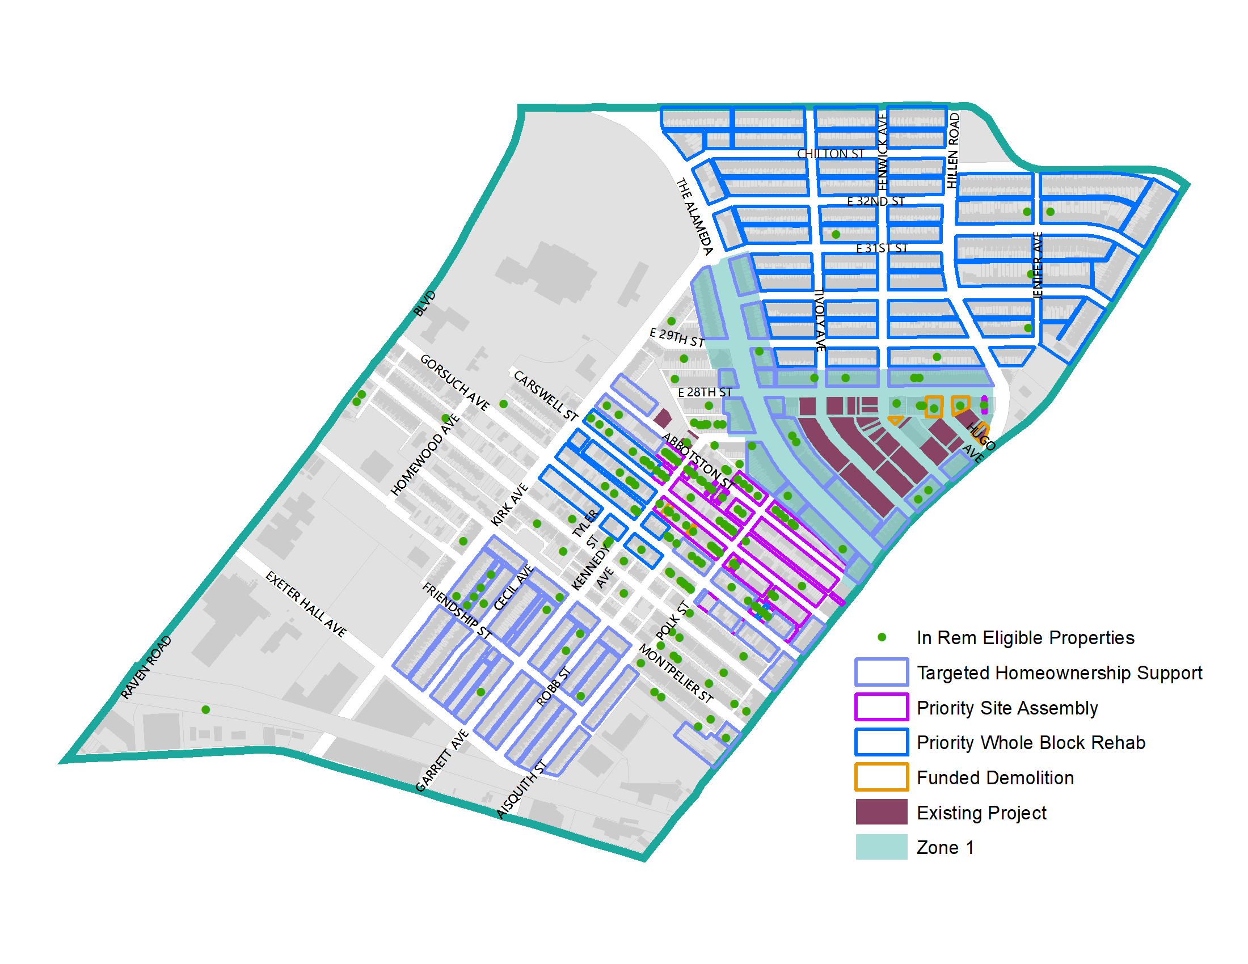
Block Level Planning
Targeted Homeownership Support
Priority Site Assembly and Whole Block Rehab
Demolition and Stabilization
Notes:
Homeownership: Tivoly Eco Village re-development requires coordinated strategies with DHCD, DPW, and DOT, to establish new physical connections for redeveloped blocks, re-designed entrance points, and controlled traffic patterns to create a thriving residential community.
Priority Site Assembly: Vacant lots in 1600 blocks of Abbotston, Gorsuch and Carswell in In Rem foreclosure.
Demolition and Stabilization: Demolition and acquisition for Briscoe Park (?) Demo along 1500 Abbotston?

Slide 10
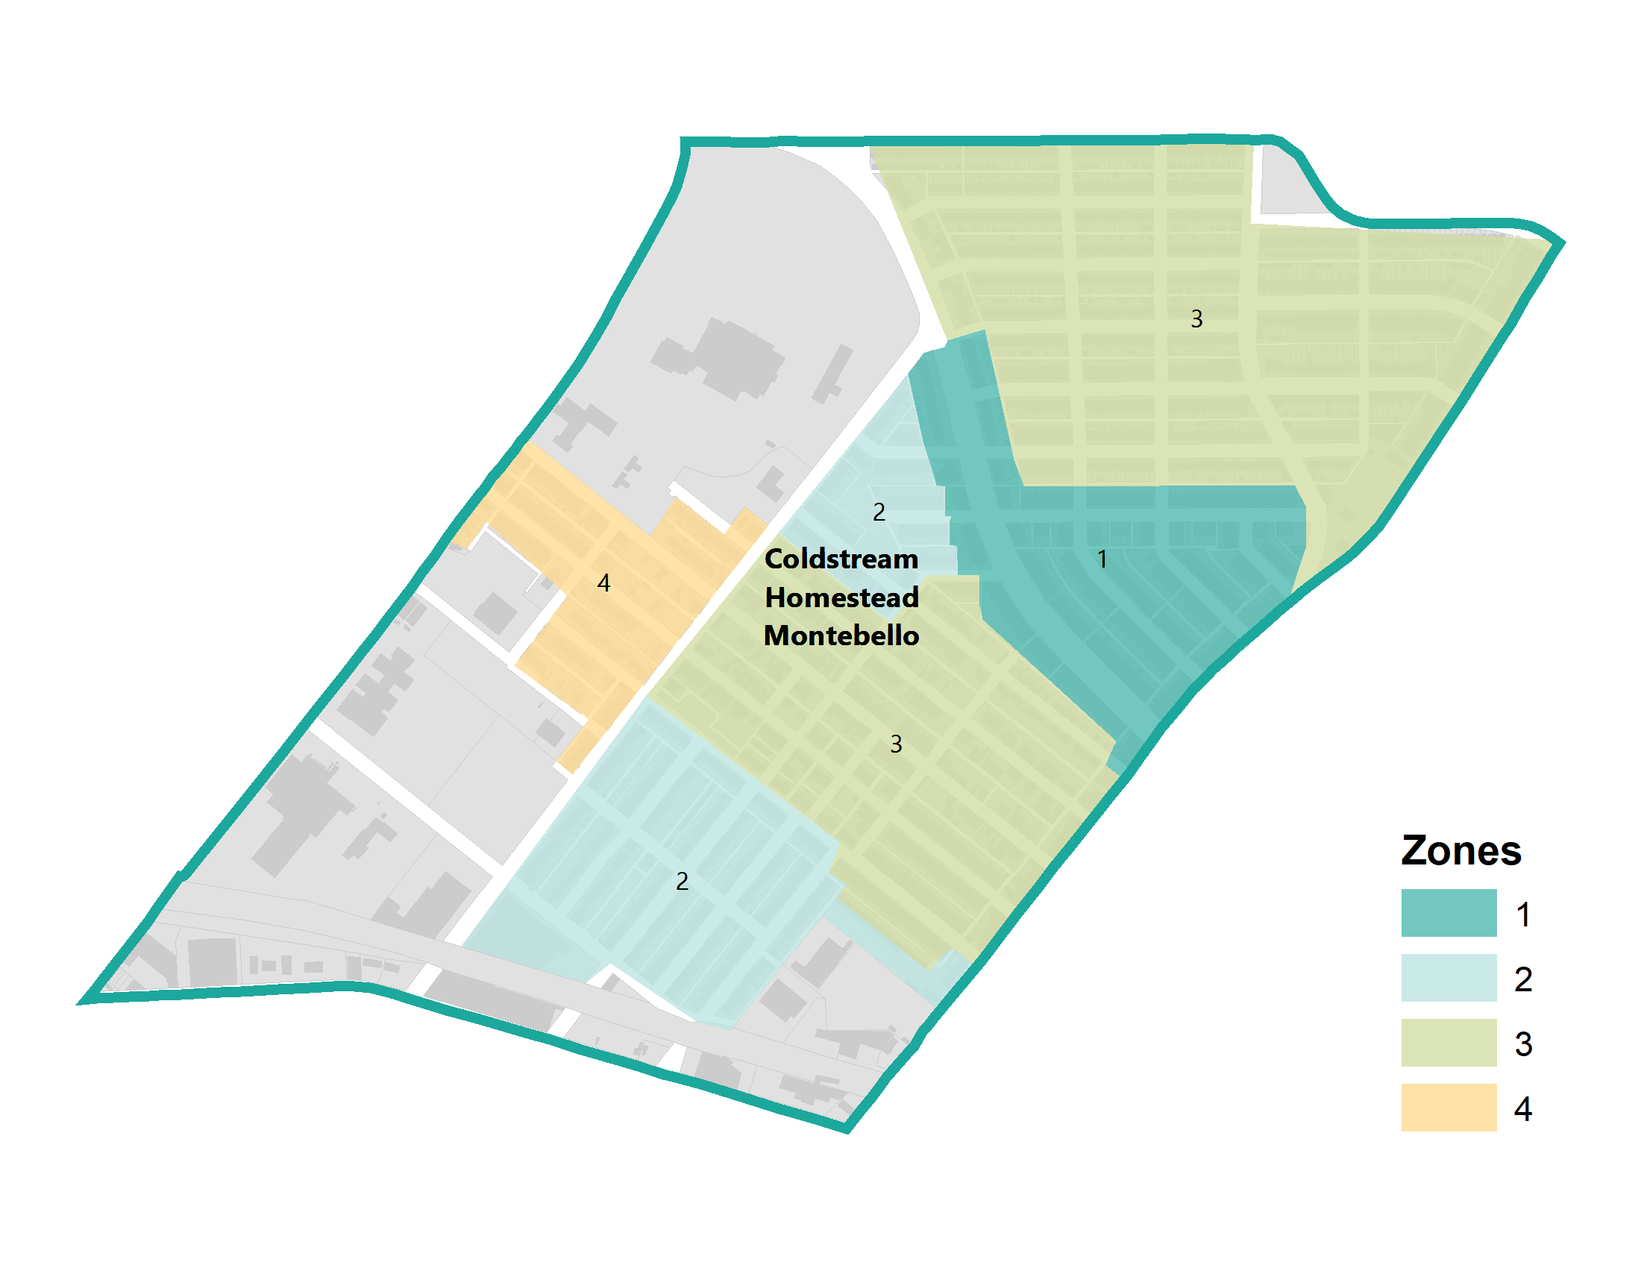
Community Development Zones (CDZ)
Ongoing projects related to development
Focus on homeownership, new construction and/or rehab of vacant homes
Notes:
Define Zones – Connect project tracker, and talk about how we came to these zones
Guides spending, ARPA, etc. - Introduce, tools and Renovation, rehab and acquisition, stabilization, vacancy working group stuff. Specific tools that use, and ARPA.

Slide 11
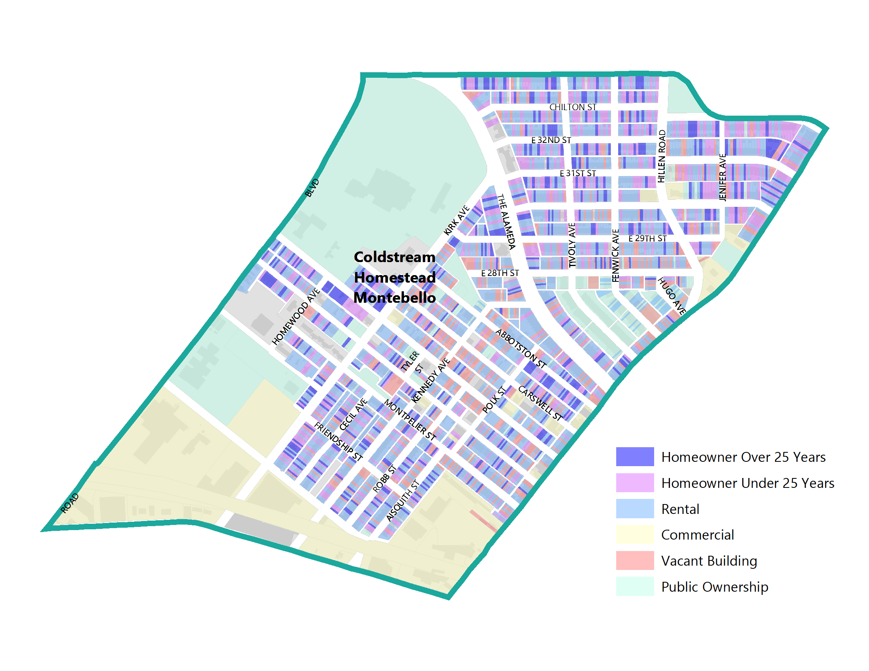
Homeownership Support
Housing and Rehabilitation Repairs
Weatherization
Lead Hazard Reduction
Tax Sale Prevention
Grants to support home buyers and businesses.
Notes:
Housing Rehabilitation and Repairs: The Office of Homeownership initiates the repair process that addresses emergencies, code violations, and health and safety issues for owner-occupied properties. Available only for eligible owner-occupied properties.
Weatherization: The Office of Homeownership initiates the process for energy efficiency improvements that lower utility bills and make homes safer and more comfortable. Available for eligible owner-and tenant-occupied properties.
Lead Hazard Reduction: The Office of Homeownership manages lead remediation projects for eligible owner- and tenant-occupied properties. Household must include a pregnant woman or a child under 6. Available for eligible owner-and tenant-occupied properties.
Tax Sale Prevention: DHCD’s Tax Sale Services Coordination and Prevention division assists homeowners in avoiding tax sale and in understanding and navigating the tax sale process
Grants: Live Near Your Work, Live Baltimore Grant, CDBG, Vacants to Value booster and Façade Improvements.

Slide 12
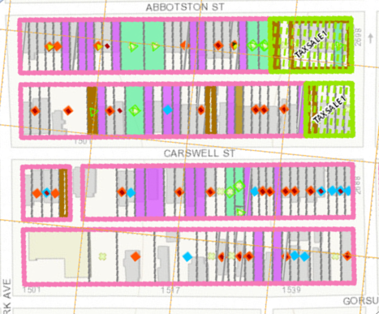
Rehab Toolkit
Support for Homeowners
Priority Stabilization
Receivership
Acquisition via In Rem and Condemnation
Notes:
Homeowner Supports: As discussed above, support for legacy homeowners in Impact Investment Areas, with a focus on Community Development Clusters as possible, is a critical strategy to ensure existing residents benefit as neighborhood’s improve.
Stabilization: Many buildings are in the middle of stable and resilient blocks and so, demolition would require further substantial construction. Additionally, Baltimore is home to many unique and beautiful buildings. Stabilization would preserve their inherent value for future use.
Receivership: Receivership has accounted for hundreds of vacant building rehabs in the city and Baltimore is nationally-recognized as a leader in the practice.
Acquisition through Tax Sale Foreclosure and Condemnation: This provides the City significant leverage in supporting specific outcomes for the redevelopment of the property through a subsequent competitive bid process. This could include production of affordable units and/or homeownership units. The City can also engage in Donations, Negotiated Sales, and Property Swaps as methods of property acquisition.

Slide 13
Project Tracker
Overview
Mayor’s Office, DHCD, DOP
DHCD.Baltimorecity.gov

Slide 14
Project Tracker
From Theory to Practice: Introduction of DHCD’s IIA Project Tracker
Project Tracker || bit.ly/3cfg0xo || Kimberly.Rubens@baltimorecity.gov
Project Title | Action Steps | Responsible Organization | Status | Status Notes | Timeline
Tivoly Eco Village: Acquisition & Demolition | Complete | DHCD | Complete | Acquisition/demolition completed for Ph 1
Tivoly Eco Village: Pre-development & Public Infrastructure Installation | Finalize LDA. Secure grant funds (EDI, BRNI, ARPA). Complete HUD Environmental Review. | DHCD, Urban Green LLC | In progress | Finalizing funding agreement with the Developer. DHCD is working on paperwork with HUD and State DHCD for grant funds. HUD Environmental Review must be complete before any funds are spent. DHCD is working on revisions to ARPA application. | 3-5 months for HUD environmental review 4-6 weeks for review of all developer and grant agreements before submitting to BOE for approval; 4-6 weeks for ARPA revisions before BOE approval;
Tivoly Evo Village: Community Engagement |  | Urban Green LLC, CHM, DHCD, DOP | Not started | Needs additional thought process and conversation | Begin in fall of 2023
Tivoly Eco Village: Phase 1 |  | Urban Green LLC | Not started | Development of first round of housing on Tivoly Avenue | Breaking ground in Fall of 2024
Tivoly Eco Village: Phase 2 |  | Urban Green LLC | Not started | Development on Hugo, Fenwick, and 28th Street | Funding needed; What is the game plan?
2800 Blk Harford Road Redevelopment | Application; Funding | DHCD; Developer to be awarded, CHM | In progress | GEDCO is the interested developer and is seeking funding support for this project.
Morgan State University at former Lake Clifton Campus | Settlement | Morgan State University, CHM, DOP, Comptroller's Office? | In progress | Passed through the BOE twice in 2022. Passed though the MSU Board of Regents. Passed through Maryland Board of Public Works. Settlement is coming soon. Campus planning needed before development.
Scattered Site Acquisition | Planning/Acquisition | DHCD | In progress | Where is DHCD working now and where will the focus be? | Ongoing
CHM Clean Corps | Active season | CivicWorks, CHM, DOP, MOED, DPW | In progress | Launched Feb 7th. AAL Agreement with Civicworks has been executed. | Expected end date: January 31, 2025

Slide 15
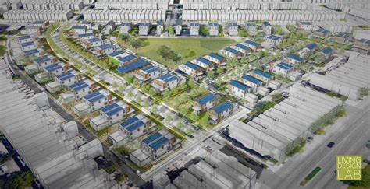
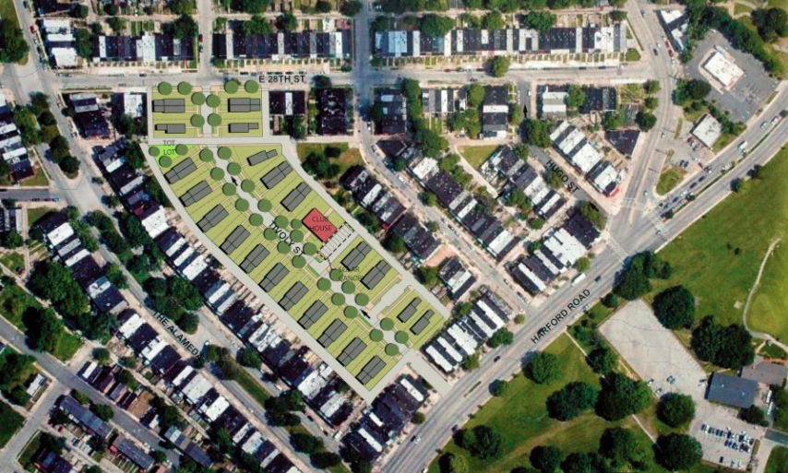
Tivoly Eco Village Development Site
City's first new construction Net Zero Homeownership community
Net-zero energy homeowners pay little to no energy costs
Allows homes to generate as much energy as they use
New construction single family homes, a community center and resilience hub featuring solar and lithium-ion batteries
Phase 1: 2700 block of Tivoly Avenue
Phase 2: 2700 blocks of Hugo and Fenwick Avenues, and portions of the 1700-1900 blocks of East 28th Street
Notes:
Project is still in the HUD Environmental Review (We said in February that it was a 3-5 month process from that point).

Slide 16
Engagement Session
Mayor’s Office, DHCD, DOP
DHCD.Baltimorecity.gov

Slide 17
COMMUNITY ASSETS
________________________
IDENTIFYING NUISANCE PROPERTIES
________________________
STABILIZATION
___________________________________________
DEMOLITION
__________________________________________
BEAUTIFICATION & GREENSPACE
COMMUNITY FEEDBACK EXERCISE & DISCUSSION
Notes:
Define what we are looking for from the community.
We are NOT trying to re-write the Master Plan. We are assessing the master plan, what has been completed, what strategies have been working, what hasn’t, what should we do moving forward?
The information gathered here today will guide spending, in addition to actions already taken through this process
Prioritizing areas for homeownership, stabilization, demolition, beautification, identifying nuisance properties, community assets.

Slide 18
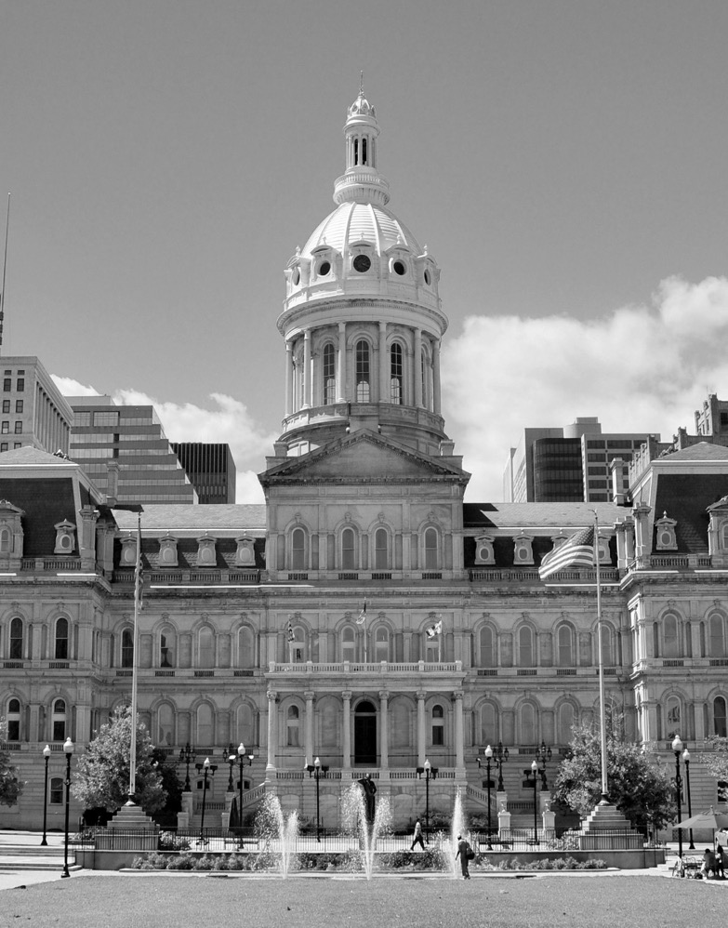
Next Steps and Closing

Slide 19
Thank You!
Mayor’s Office, DHCD, DOP
DHCD.Baltimorecity.gov

