Slide 1
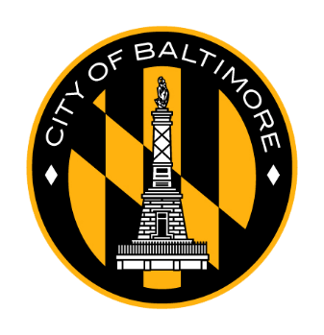
Community
Conversations
Mayor’s Office, DHCD, DOP
Monday, September 25, 2023
Baltimore, City

Slide 2
AGENDA
Part 1:
Welcome & Introductions
Statement of Occasion
Part 2:
IIA Broadway East Overview
Project Tracker Overview
Part 3:
Neighborhood Discussion Session Overview
Neighborhood Discussion Session
Part 4:
Wrap Up & Next Steps

Slide 3
Welcome
Introductions & Occasion
Mayor’s Office, DHCD, DOP
DHCD.Baltimorecity.gov

Slide 4
WELCOME
Dr. Doris Minor-Terrell, Executive Director New Broadway East CDC
OCCASION & REMARKS
Mayor Brandon Scott
Nichole Stweart-DoP
Alice Kennedy - DHCD

Slide 5
Neighborhood Subcabinet/Working Groups/Community Conversations Structure
 | NEIGHBORHOOD SUBCABINET | WORKING GROUPS | COMMUNITY CONVERSATIONS
Engagement Structure | Cabinet-level oversight and resource prioritization | Department-level planning and implementation | Community-level engagement and information sharing
Objective | Oversee implementation of City’s community development strategy to create and support thriving, equitable neighborhoods. | Identify the overarching goals, identify priorities, assign tasks, give status updates, and develop initiatives in the 7 Impact Investment Areas (IIAs). This group includes City agency partners and community leadership, working in around target areas and initiatives. | Inform and get feedback from community about DHCD’s Impact Investment Area (IIA) Implementation Strategy documents. These meetings will be open to the public and will use the following agenda: (subject to change)

Slide 6
Neighborhood Subcabinet/Working Groups/Community Conversations Structure
Executive level prioritization, oversight and resource alignment
Neighborhood Subcabinet
Mayor
Deputy Mayors
Agency Heads
Working Group
(7) Impact Investment Areas
Neighborhood Development Officers
City Planners
Councilmembers
Community Development Organizations
Neighborhood Associations
Agency level planning and implementation with neighborhood partners
Community level information-sharing and general feedback
Community Conversation
City Agencies
General Public
Neighborhood Stakeholders

Slide 7
Broadway East IIA
Implementation Strategy Overview
Mayor’s Office, DHCD, DOP
DHCD.Baltimorecity.gov

Slide 8
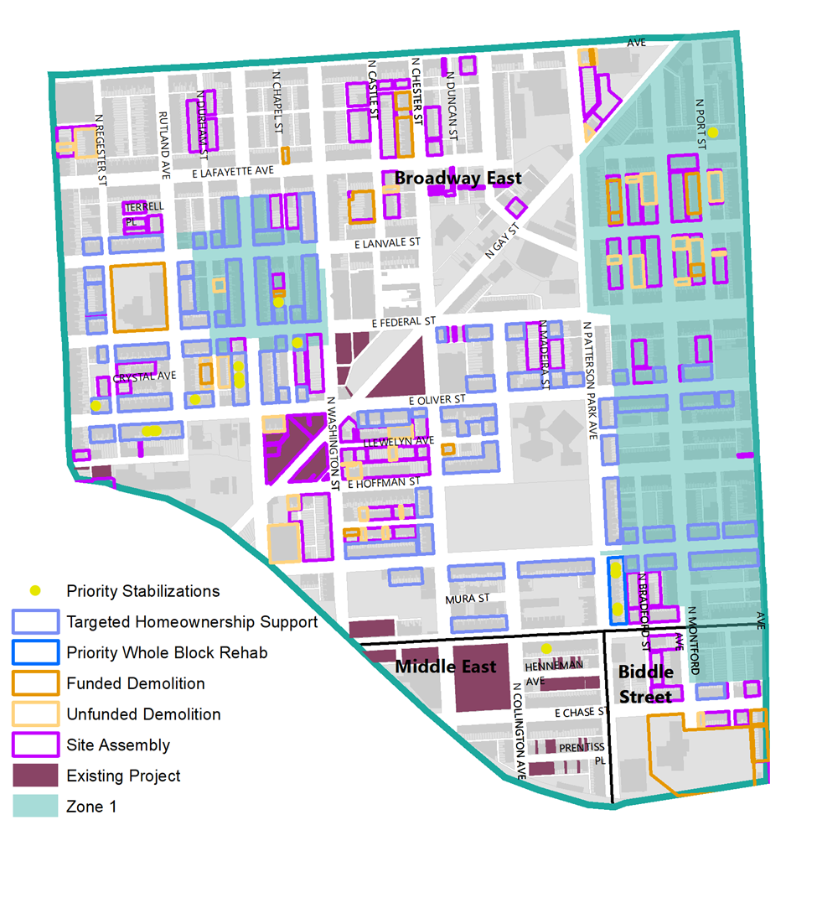
Block Level Planning
-

Slide 9
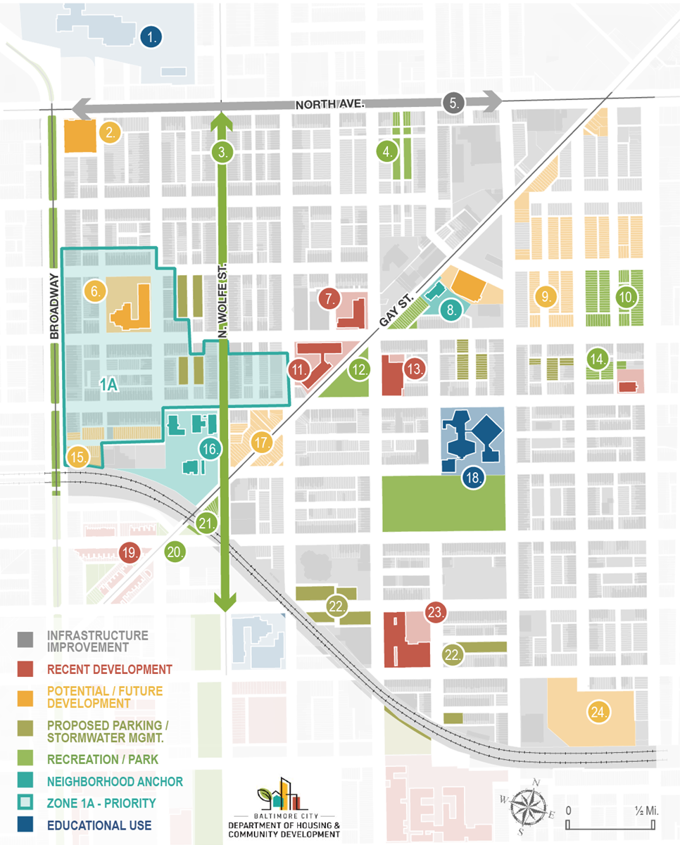
Building From Strength
Harford Heights Sharpe Elem. – 21st Century Schools and INSPIRE
Gompers Building
Duncan Street Miracle Garden
North Avenue Rising
Rutland School site
Mary Harvin Apartments
Humanim / American Brewery Building
Baltimore Pumphouse
Hoen & Lithograph Building / Center for Neighborhood Innovation
Dr. Raynor Browne school site
Notes:
The IIAs were first identified in the 2019 DHCD Community Development Framework
They are areas of the City that are poised for transformational revitalization at the neighborhood level based on their existing assets, current redevelopment activity, and proximity to already shifting markets.
The West IIA is composed of the Penn North, Druid Heights, and Upton neighborhoods. These neighborhoods have a rich history in Baltimore and especially within the African American Community. There are also many assets to build from in these neighborhoods including:
The Black Arts District
· Pennsylvania Ave. Main Street and The Avenue Market
· Historic Assets- West Baltimore National register historic districts, Historic Marble Hill, and key historic buildings including, the Arch Social Club, the Sphynx Club, the Upton Mansion, historic PS 103 – all of which currently have renovation or redevelopment plans underway
· New Housing Developments – Bakers View 1 & 2 – new rowhouse development, planned rehab of the 2200 block of Druid Hill Ave., the completed Marshall Gardens development, and the renovation of the 800 blocks of Harlem and Edmondson and many more development opportunities and projects underway
· Recreational assets - Shake and Bake Family Fun Center, Planned Parkview Recreation Center, Cab Calloway Legends Square Park and improvements to the Robert C. Marshall field
· Transportation Initiatives - North Avenue Rising – street improvements, Druid Park Lake Drive Complete Streets study, MTA Transit Oriented Development Concept – development opportunity
The theory of the IIAs is that we can build from these strengths to revitalize these communities with concentrated investment, coordinated deployment of city services and resources, and by working directly with neighborhood residents and stakeholders to develop databased implementation strategies.
We have been working with neighborhood leaders and residents over the past 2 years developing these strategies, identifying priorities, and seeking funding for implementation. This has resulted in the Draft Implementation Strategy document that was shared online and that we will be discussing today.
Our goal today is to broaden the conversation by sharing this work with a broader audience and get feedback to help finalize the document.

Slide 10
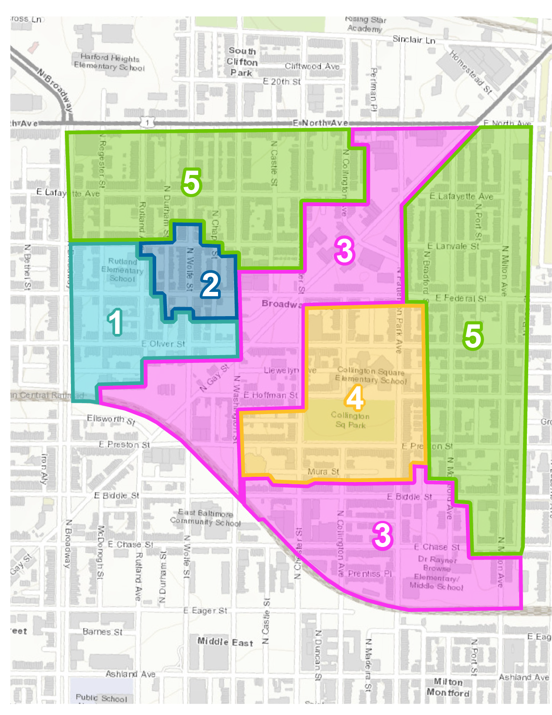
Community Development Zones
Notes:
Define Zones – Connect project tracker, and talk about how we came to these zones
Guides spending, ARPA, etc. - Introduce, tools and Renovation, rehab and acquisition, stabilization, vacancy working group stuff. Specific tools that use, and ARPA.

Slide 11
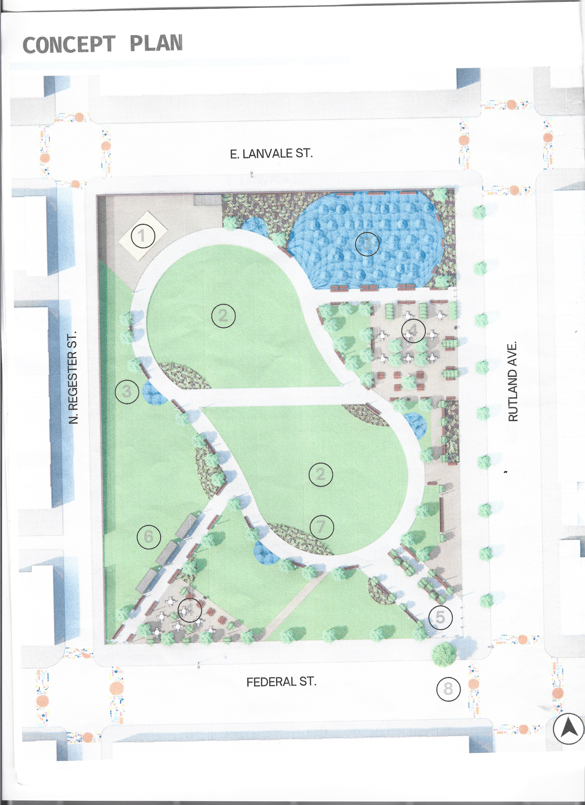
Rutland Concept Plan
https://theurbanstudio.org/courtney-morgan
Notes:
Define Zones – Connect project tracker, and talk about how we came to these zones
Guides spending, ARPA, etc. - Introduce, tools and Renovation, rehab and acquisition, stabilization, vacancy working group stuff. Specific tools that use, and ARPA.

Slide 12
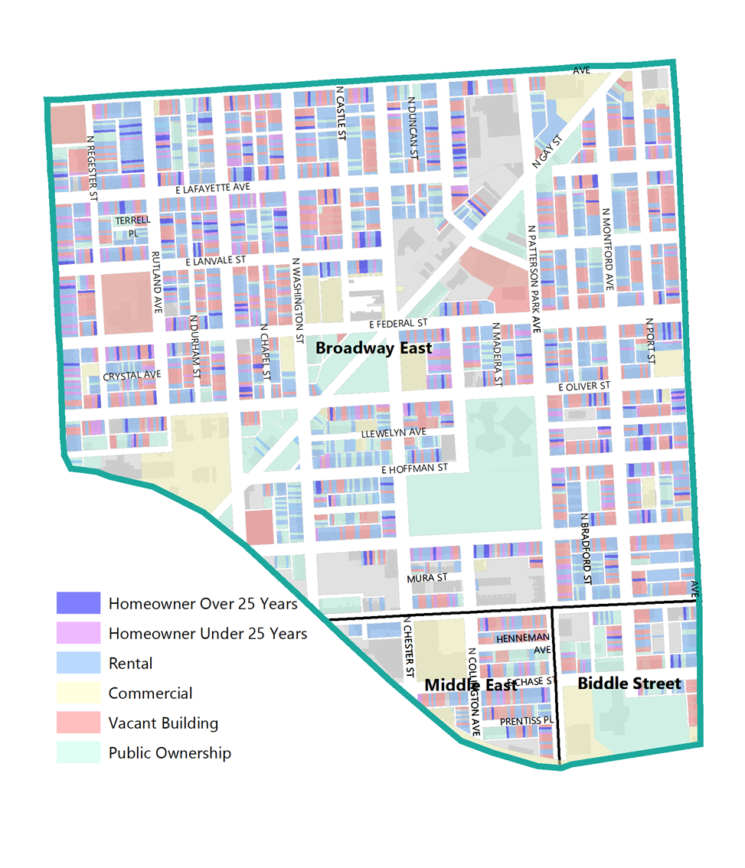
Homeowner Support
Housing and Rehabilitation Repairs
Weatherization
Lead Hazard Reduction
Tax Sale Prevention
Notes:
Analysis of current conditions helped to develop recommendations for the tools to use for different areas – Data Based
The West Implementation Strategy document provides a recommended set of actions and investments which the City and partners will implement. These recommendations are based on our iterative, detailed planning process and engagement over the last 18 months. In addition to the monthly Work Groups, City staff engaged in data-driven, planning workshops across multiple divisions at DHCD and at DoP to provide detailed, analytical understanding of opportunities and challenges in each neighborhood. The purpose of the Implementation Strategy is to draw on these workshops to codify existing commitments, strengthen the platform for ongoing collaboration with community partners and stakeholders, and focus on hyper-local factors such as legacy homeowners, proximity to assets, and housing stock to make smart and targeted community-based development decisions.

Slide 13
Rehab Priority Blocks and Properties
1700 block of Oliver Street
1713-1747 E Lanvale
1701-1711 E Lanvale
1603-1629 Rutland- Rehab
1700-1800 E North Ave- Odd side
1800 block of N Collington
1500 block of N Wolfe Street
1600 block of Regester
2000 block of Oliver, odd side
Notes:
Analysis of current conditions helped to develop recommendations for the tools to use for different areas – Data Based
The West Implementation Strategy document provides a recommended set of actions and investments which the City and partners will implement. These recommendations are based on our iterative, detailed planning process and engagement over the last 18 months. In addition to the monthly Work Groups, City staff engaged in data-driven, planning workshops across multiple divisions at DHCD and at DoP to provide detailed, analytical understanding of opportunities and challenges in each neighborhood. The purpose of the Implementation Strategy is to draw on these workshops to codify existing commitments, strengthen the platform for ongoing collaboration with community partners and stakeholders, and focus on hyper-local factors such as legacy homeowners, proximity to assets, and housing stock to make smart and targeted community-based development decisions.

Slide 14
Project Tracker
Overview
Mayor’s Office, DHCD, DOP
DHCD.Baltimorecity.gov

Slide 15
Project Tracker
From Theory to Practice: Introduction of DHCD’s IIA Project Tracker
Project Tracker || bit.ly/3cfg0xo || Kimberly.Rubens@baltimorecity.gov

Slide 16
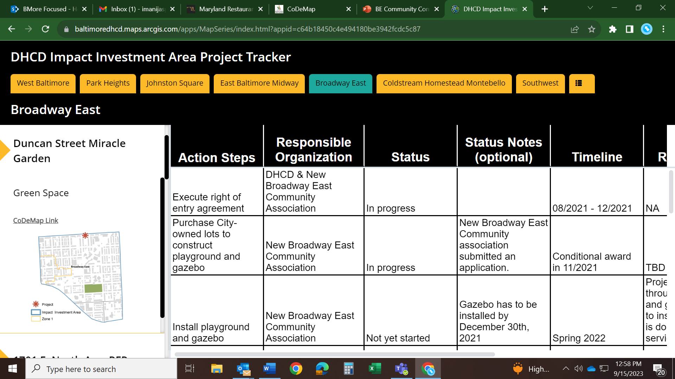
Project Tracker
From Theory to Practice: Introduction of DHCD’s IIA Project Tracker
Project Tracker || bit.ly/3cfg0xo || Kimberly.Rubens@baltimorecity.gov

Slide 17
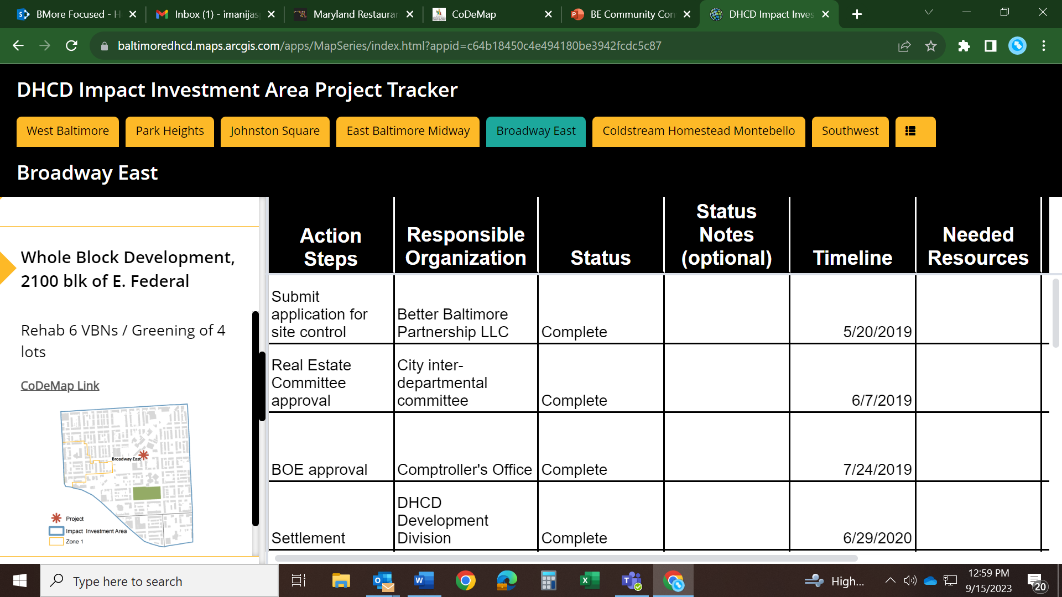
Project Tracker
From Theory to Practice: Introduction of DHCD’s IIA Project Tracker
Project Tracker || bit.ly/3cfg0xo || Kimberly.Rubens@baltimorecity.gov

Slide 18
Engagement Session
Mayor’s Office, DHCD, DOP
DHCD.Baltimorecity.gov

Slide 19
COMMUNITY ASSETS
________________________
IDENTIFYING NUISANCE PROPERTIES
________________________
STABILIZATION
___________________________________________
DEMOLITION
__________________________________________
BEAUTIFICATION & GREENSPACE
COMMUNITY FEEDBACK & DISCUSSION
Notes:
Define Zones – Connect project tracker, and talk about how we came to these zones
Guides spending, ARPA, etc. - Introduce, tools and Renovation, rehab and acquisition, stabilization, vacancy working group stuff. Specific tools that use, and ARPA.

Slide 20
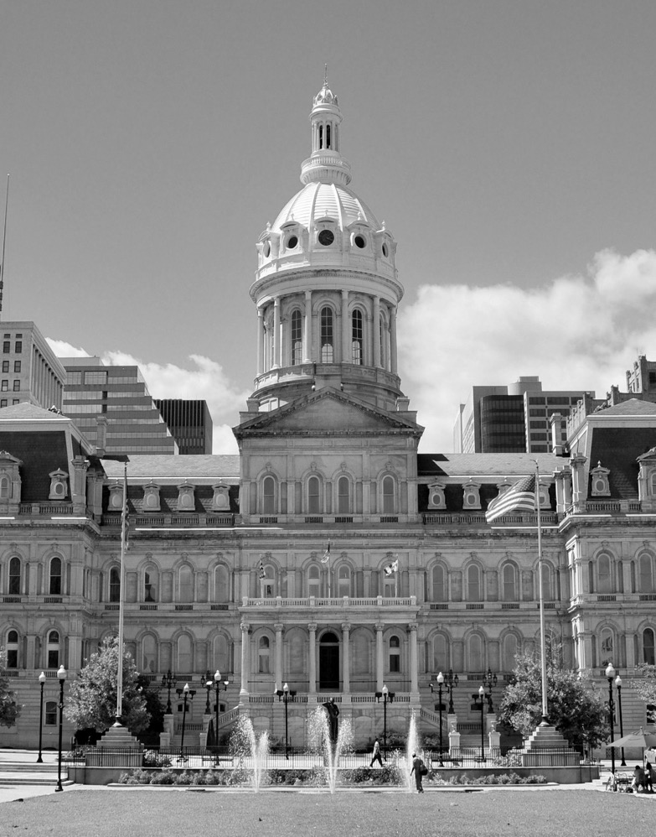
Next Steps
September 26: Next Broadway East IIA Workgroup Meeting
REMINDER: Online survey closes on October 13th
Finalize implementation strategy using feedback from tonight
October 25: Next Mayors Subcabinet Meeting
Create strategy for rehab and reuse of Gompers Building with Broadway East community

Slide 21
Closing Comments

Slide 22
Thank You!
Mayor’s Office, DHCD, DOP
DHCD.Baltimorecity.gov

