Slide 1
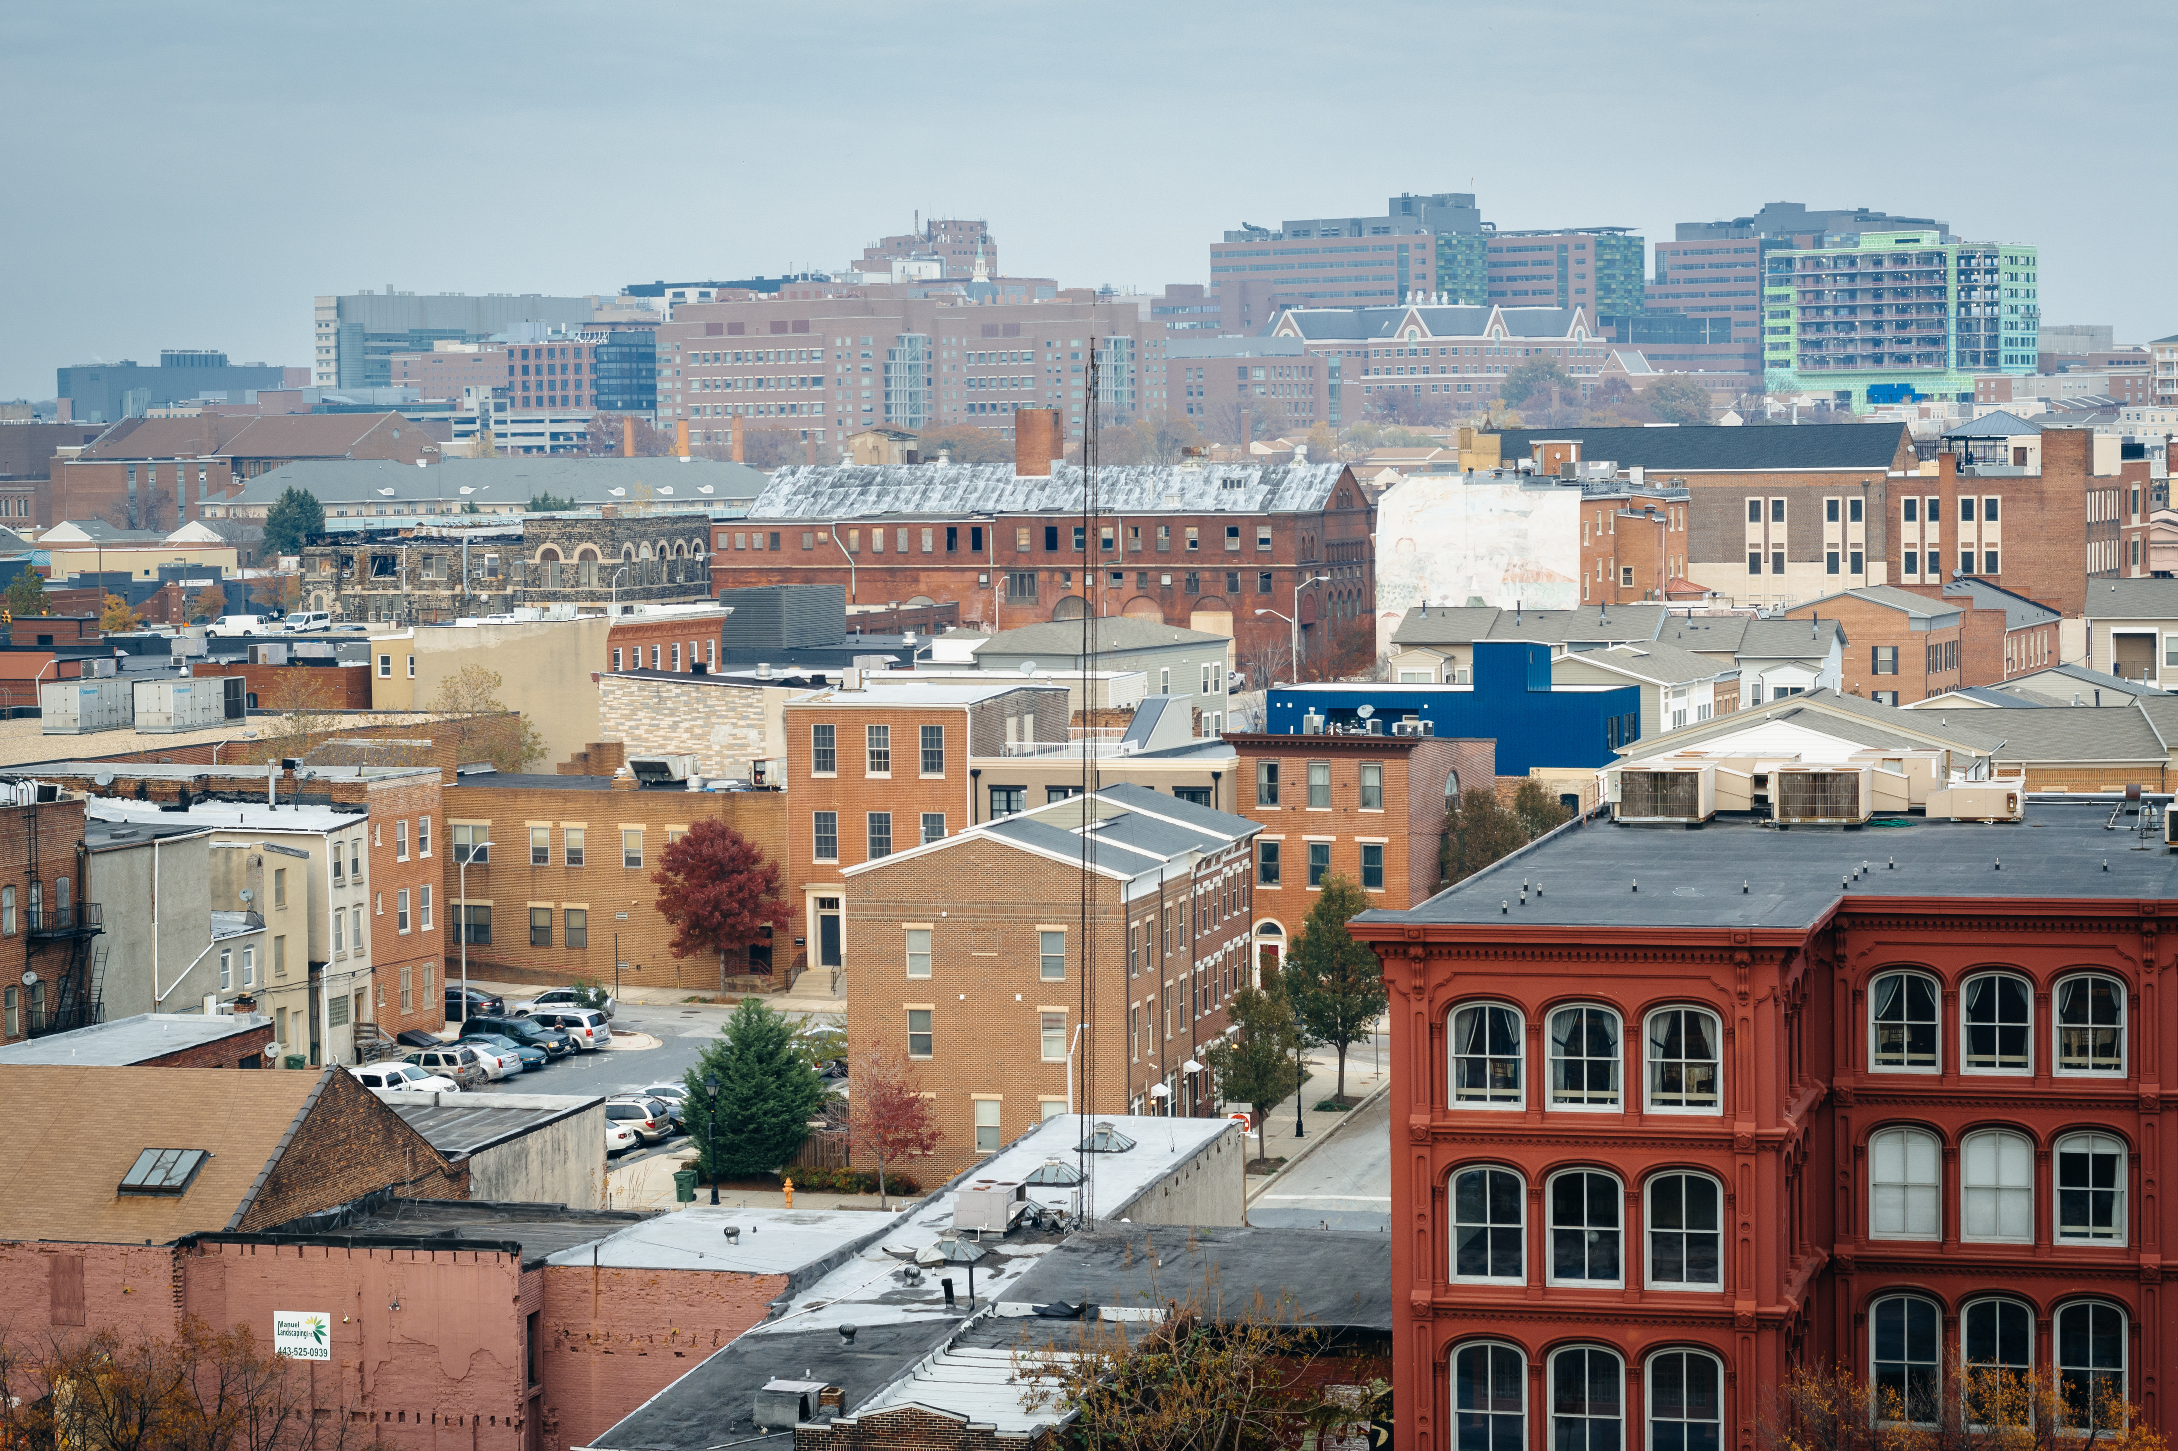
AHTF Program and Revenue Update
January 23, 2024
01/23/2024

Slide 2
Presentation Agenda Items
1. Affordable Housing Trust Fund Revenue
2. Trust Fund Commitments/Expenditures
Affordable Housing Trust Fund
Project Status Overview
NOFA Update
Long term voucher program update
Commission Bylaws
Inclusionary Housing
Commission Nominations Update
01/23/2024

Slide 3
October 2023 – December 2023
December 2023
Monthly Revenue: $418,046.68
November 2023
Monthly Revenue: $451,011.00
October 2023
Monthly Revenue: $1,154,019.62
01/23/2024

Slide 4
Revenue collected thru December 23
Revenue collected to date
$23,323,516
01/23/2024
Notes:
Duplicate entry 12,352 was deducted from revenue to correct an overcharge of transfer tax

Slide 5
Revenue Contribution type by year thru December 23
01/23/2024
Notes:
Updated city contribution to 6.5 million and surplus money was updated to 6,571,376

Slide 6
Funding Source Totals Since inception
01/23/2024
Notes:
No life to date

Slide 7
December 23 Commitments/Expenditures
Commitments | Amount Allocated FY/21,22,23,24 | Amount awarded/ Transferred | Expended to date
CLT Project Commitments | $23,813,406.00 | $14,545,224.00 | $1,903,747.11*corrected
NC/PE-Rental | $26,868,113.00 | $20,296,500.00 | $1,412,176.00
Senior Homeownership | $9,383,066.00 | $7,793,066.00 | $5,436,439 (336 households @30% AMI) good thru December
Choice Neighborhoods | $8,375,207.00 | $1,500,000.00 | $1,500,000.00
Rent Supplement | $6,289,393.00 | $2,900,000.00 | $1,700,000.00
Inclusionary Housing | $552,527.00 | $100,000.00 | $100,000.00
Flex Fund | $1,275,000.00
Pandemic Homelessness | $2,750,000.00 | $2,750,000.00 | $2,750,000.00 (494 households @30%AMI)
Administrative Costs | $4,540,373.75 | $4,540,373.75 | $2,641,146.91
Surplus from prior years |  |  | Transferred to FY23 budget
Total | $83,847,085.75 | $46,161,913.75 | $17,455,102.82
01/23/2024

Slide 8
December 23-Award Status Overview
Categories | Total Projects
Awards Awarded | 49
Due Diligence/Term Negotiations | 35
Grant Agreement Draft Sent | 28
Audit Review | 21
Audit’s Approved | 20
BOE Requested | 20
BOE Approved | 19
Disbursement | 10
Compliance | 3

Slide 9
NOFA INFORMATION
New Construction/Preservation of Existing Rental Housing NOFA’s
Round 1,2, 3 & 4 Summary Info
Deal Structuring
Presenting agreements to BOE for approval
Preparing for settlement
Round 5
Rental NOFA was up for public comments
Public comments was accepted until December 19th
Public comment summary was sent around to all the commissioners for their review and comments.
The NOFA will open February 2, 2024
DHCD will be making up to $7 million available
1 million of that money will be set aside for Community Land Trust rental projects
01/23/2024

Slide 10
NOFA INFORMATION
Community Land Trust
Single Family Homeownership NOFA
Round 1, 2, 3
Deal Structuring
Presenting agreements to BOE for approval
Preparing for settlement
Community Land Trust Rental NOFA-
Round 1
Deal Structuring
Operating NOFA
Round 1
All agreements have been approved by the BOE
Operating NOFA
Round 2
Kickoff meetings are being scheduled and grant agreements drafted for boe approvals
Community Land Trust
NOFA’s
01/23/2024

Slide 11
NOFA INFORMATION
Community Land Trust
Single Family Homeownership NOFA
(Round 4)
Rolling NOFA opened on June 30th
DHCD made up to $4,000,000 available
Community Land Trust Projects can request up to $1,000,000 per project.
NOFA will run until June 30th 2024 or until funds run out.
If the funds don’t run out they will roll over to the next FY bucket of money.
No applications have been submitted.
Share Baltimore is continuing to work with CLT’s to help with their submissions.
Community Land Trust
NOFA’s
01/23/2024

Slide 12
Long Term Voucher Program Pros and Cons
DHCD is working on the RFP draft to request a consultant to help make a decision on what type of long-term voucher program we will go with.
We will send the RFP draft around to the commission for review and discuss it in the next workgroup meeting before posting it
The proposed issue date is April 1, 2024.
Notes:
FY 23 spending was estimated 12,000 in revenue, 7,000,000 in city contribution and 6,570,000 in surplus

Slide 13
Commission Bylaws
AHTF Commission Bylaws
The first draft has been sent to all commissioners for their review
Krystle sent out a message for the volunteers of the workgroup to set up the first meeting. We can have 2 more commissioners in this workgroup. Please send us your availability.
Volunteers
Kevin Daniel
Matt Hill
Amy McClain
X
x

Slide 14
Inclusionary Housing
Inclusionary Housing Legislation was passed on January 22, 2024. The bill was unanimously approved by the Baltimore City Council.
Website: Meetings and Archives | Baltimore City Department of Housing & Community Development
01/23/2024

Slide 15
AHTF Commissioner Nominations
Commissioner Nomination Updates
The Commissioner is working with MOHS to identify a representative from the Continuum of Care (COC.
*No update since last month’s update
Notes:
Application for nomination for tenant who earns 30% or less of the (AMI) has been submitted to the mayor’s office

Slide 16
THANKS!
@BmoreDhcd

